Slide 1
Interactive data analysis and visualisation:
an introduction to R Shiny apps
Reminder to install shiny
Check it’s installed ok by running one of the example apps:
shiny::runExample("01_hello")

Slide 2
Interactive data analysis and visualisation: an introduction to R Shiny apps
Naomi Bradbury nvm4@leicester.ac.uk

Slide 3
Introductions

Slide 4
Learning outcomes
Understand the kinds of projects that are suited to R Shiny
Experience of using R Shiny to:
Create a Shiny app
Produce widgets to capture user input
Code reactive data visualisations
Host apps on shinyapps.io

Slide 5
SCHEDULE
Morning
Introduction to Shiny
Tutorial: widgets and reactive data visualisations
Create a Shiny app
Host an app on shinyapps.io
Afternoon
Reactivity in Shiny
App design
Create your own app

Slide 6
What are Shiny apps?
Shiny app case studies
Introduction to Shiny

Slide 7
What are Shiny apps?
Shiny app case studies
Introduction to Shiny

Slide 8
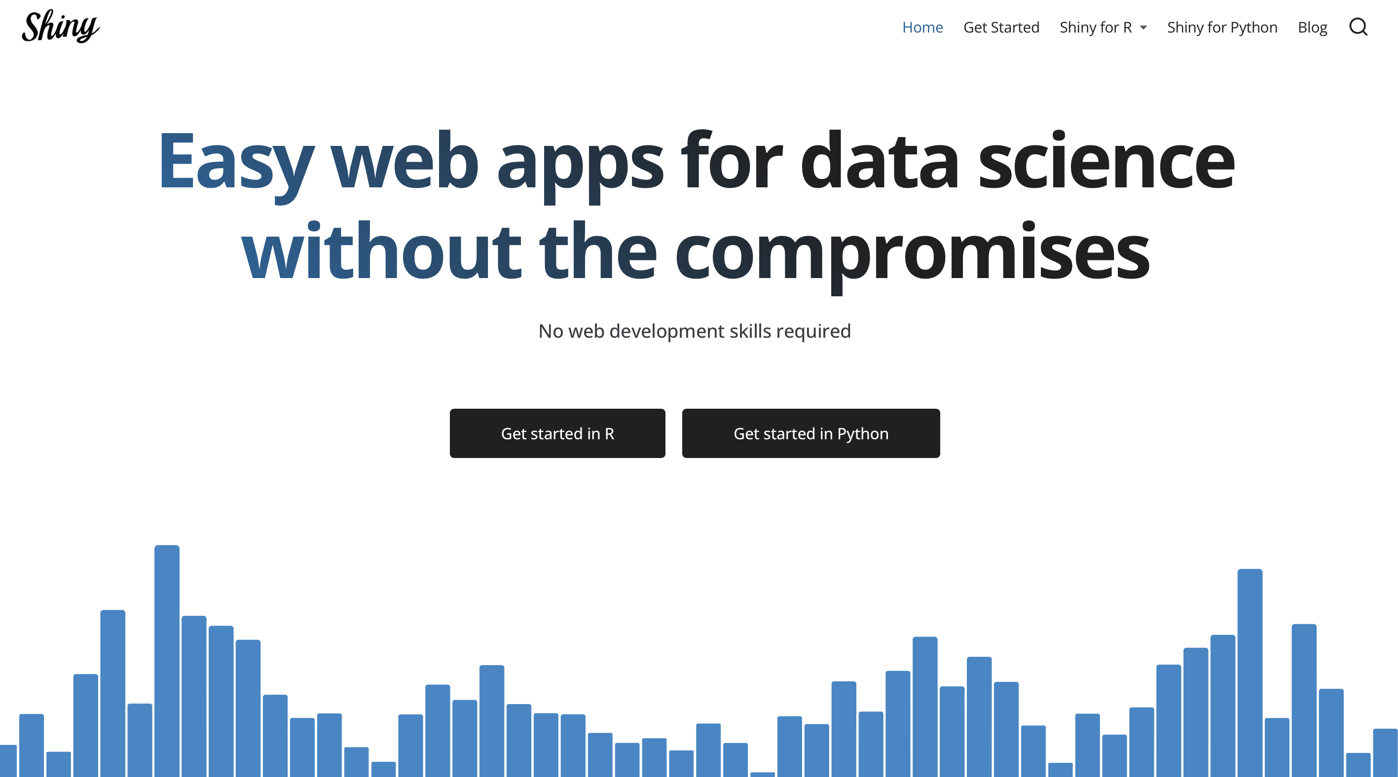
shiny.posit.co
Notes:
Calls HTML, JavaScript & CSS without you needing to know them

Slide 9
What is R Shiny?
Package in R
Contains functions for making interactive apps
An app consists of two sections: the user interface (ui or front-end) and the server (or back-end)

Slide 10
Advantages of R Shiny?
No need to know HTML/CSS/JavaScript but you can use these if you wish
Compatible with Mac/Windows/Linux
R Shiny is free and open source
Can share your results with collaborators etc. without them having to run any R code

Slide 11
What are Shiny apps?
Shiny app case studies
Introduction to Shiny

Slide 12
There is a gallery of shiny apps available at: https://shiny.posit.co/r/gallery/

Slide 13
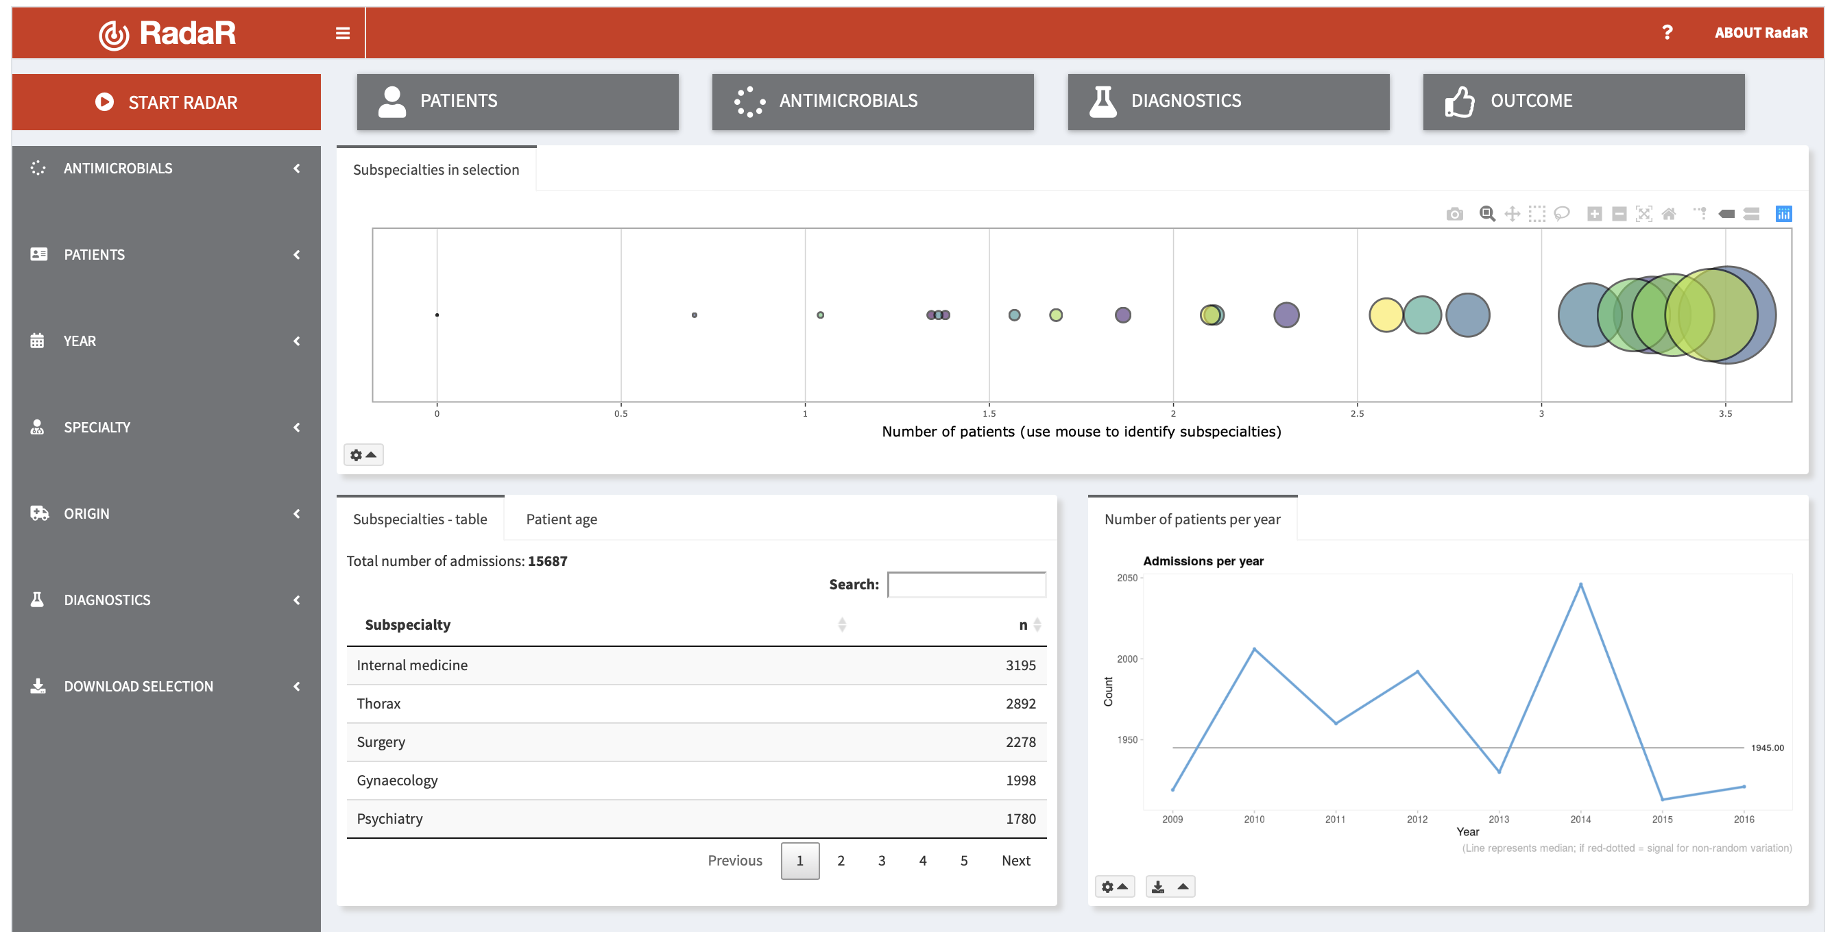
Exploring large hospital data for better use of antimicrobials
https://shiny.posit.co/r/gallery/life-sciences/hospital-data-antimicrobial/

Slide 14
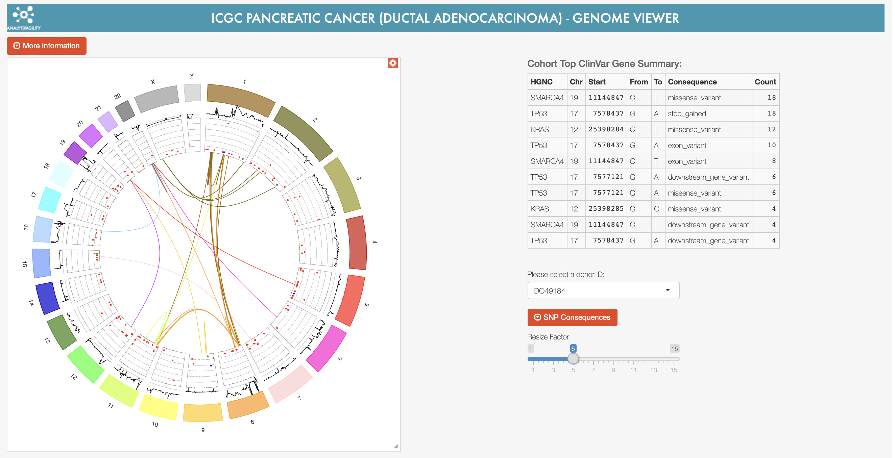
Genome browser
https://shiny.posit.co/r/gallery/life-sciences/genome-browser/

Slide 15

https://nz-stefan.shinyapps.io/commute-explorer-2/

Slide 16
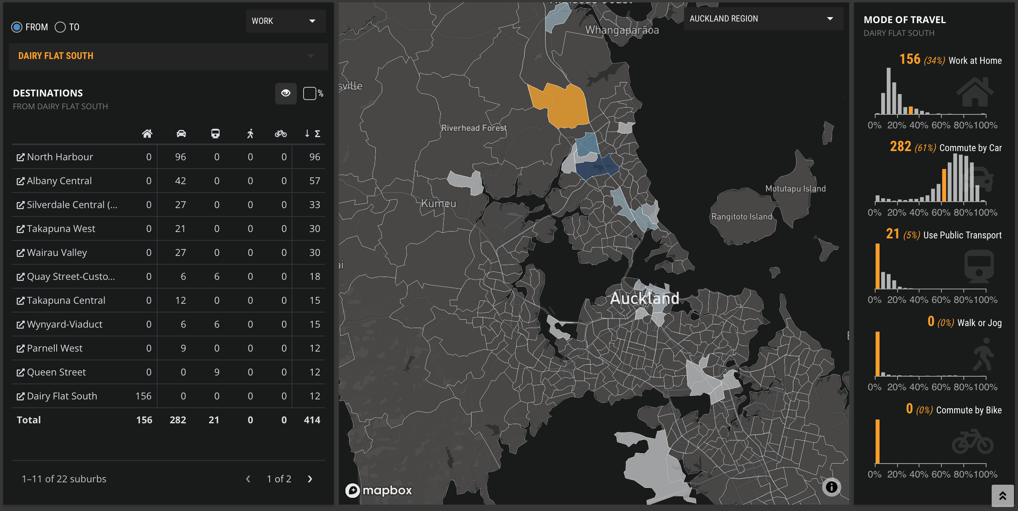

Slide 17
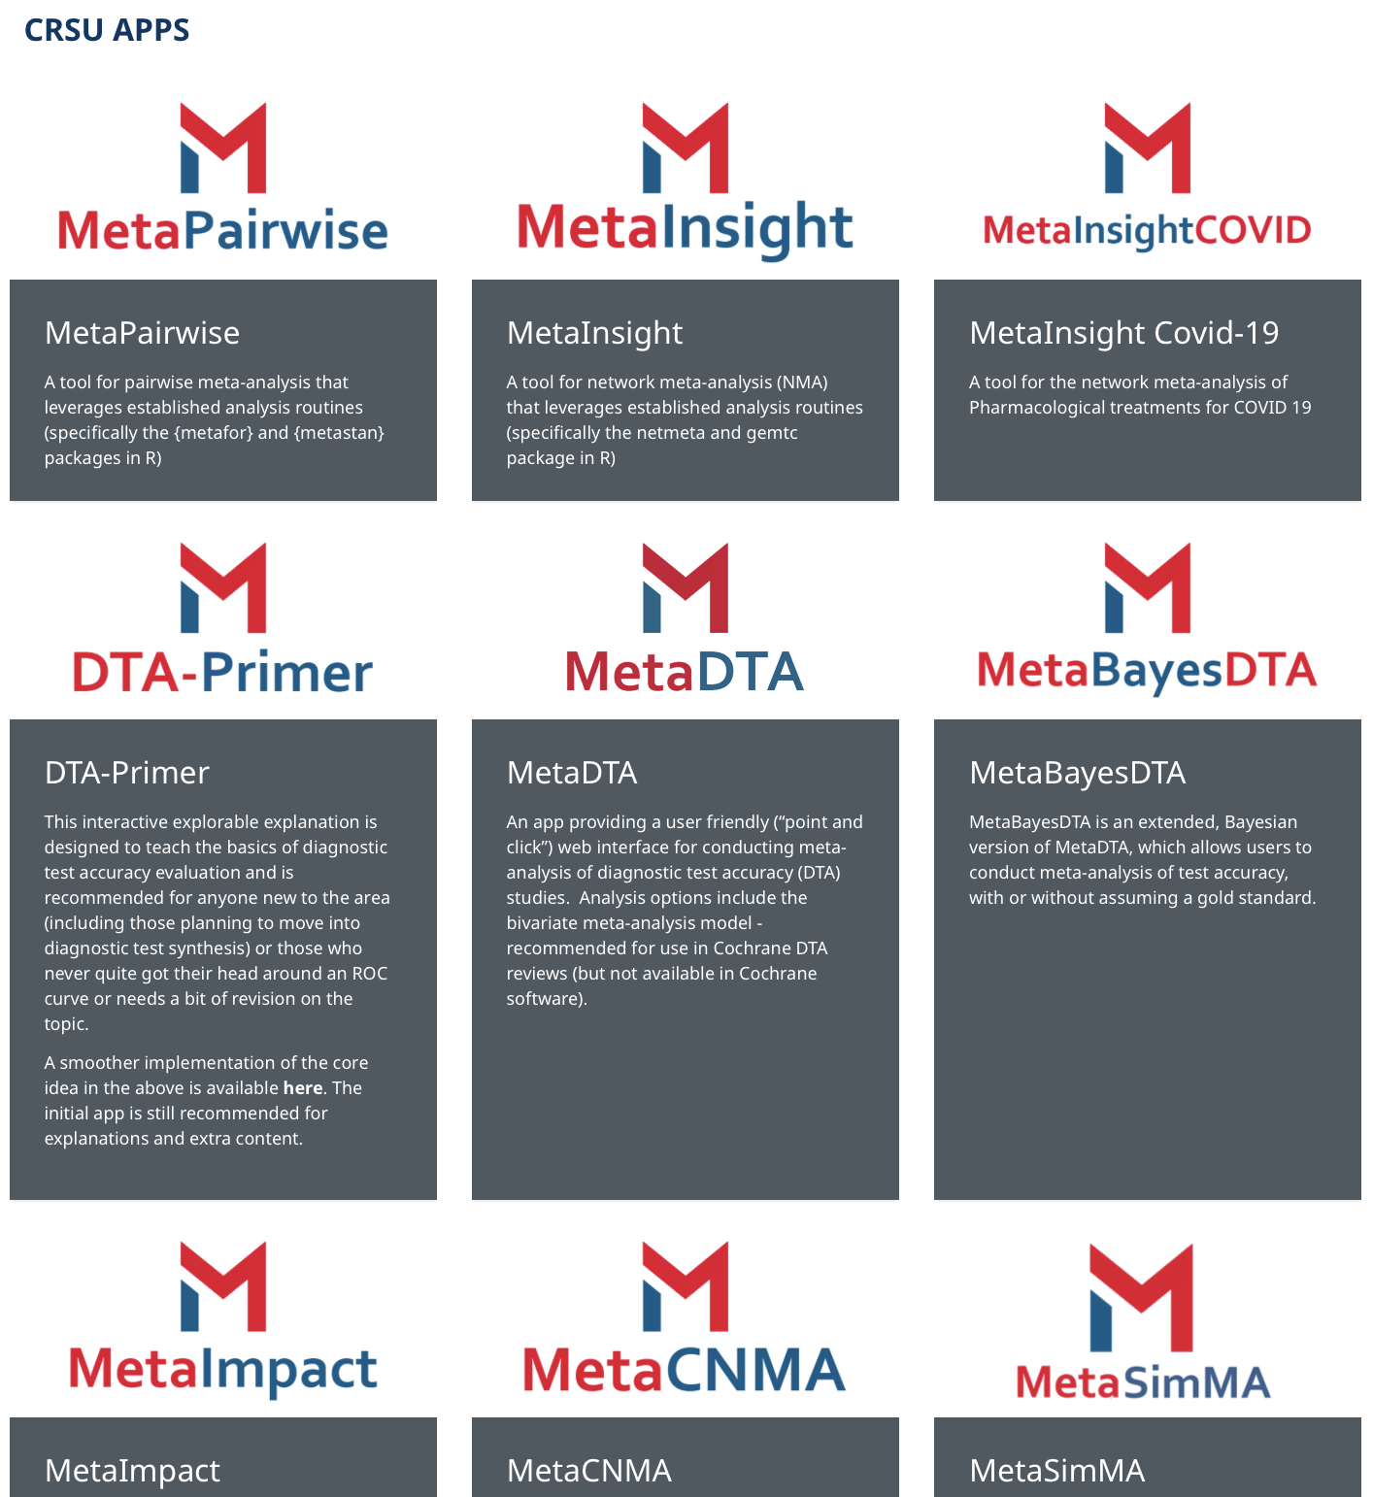
https://www.gla.ac.uk/research/az/crsu/apps/

Slide 18
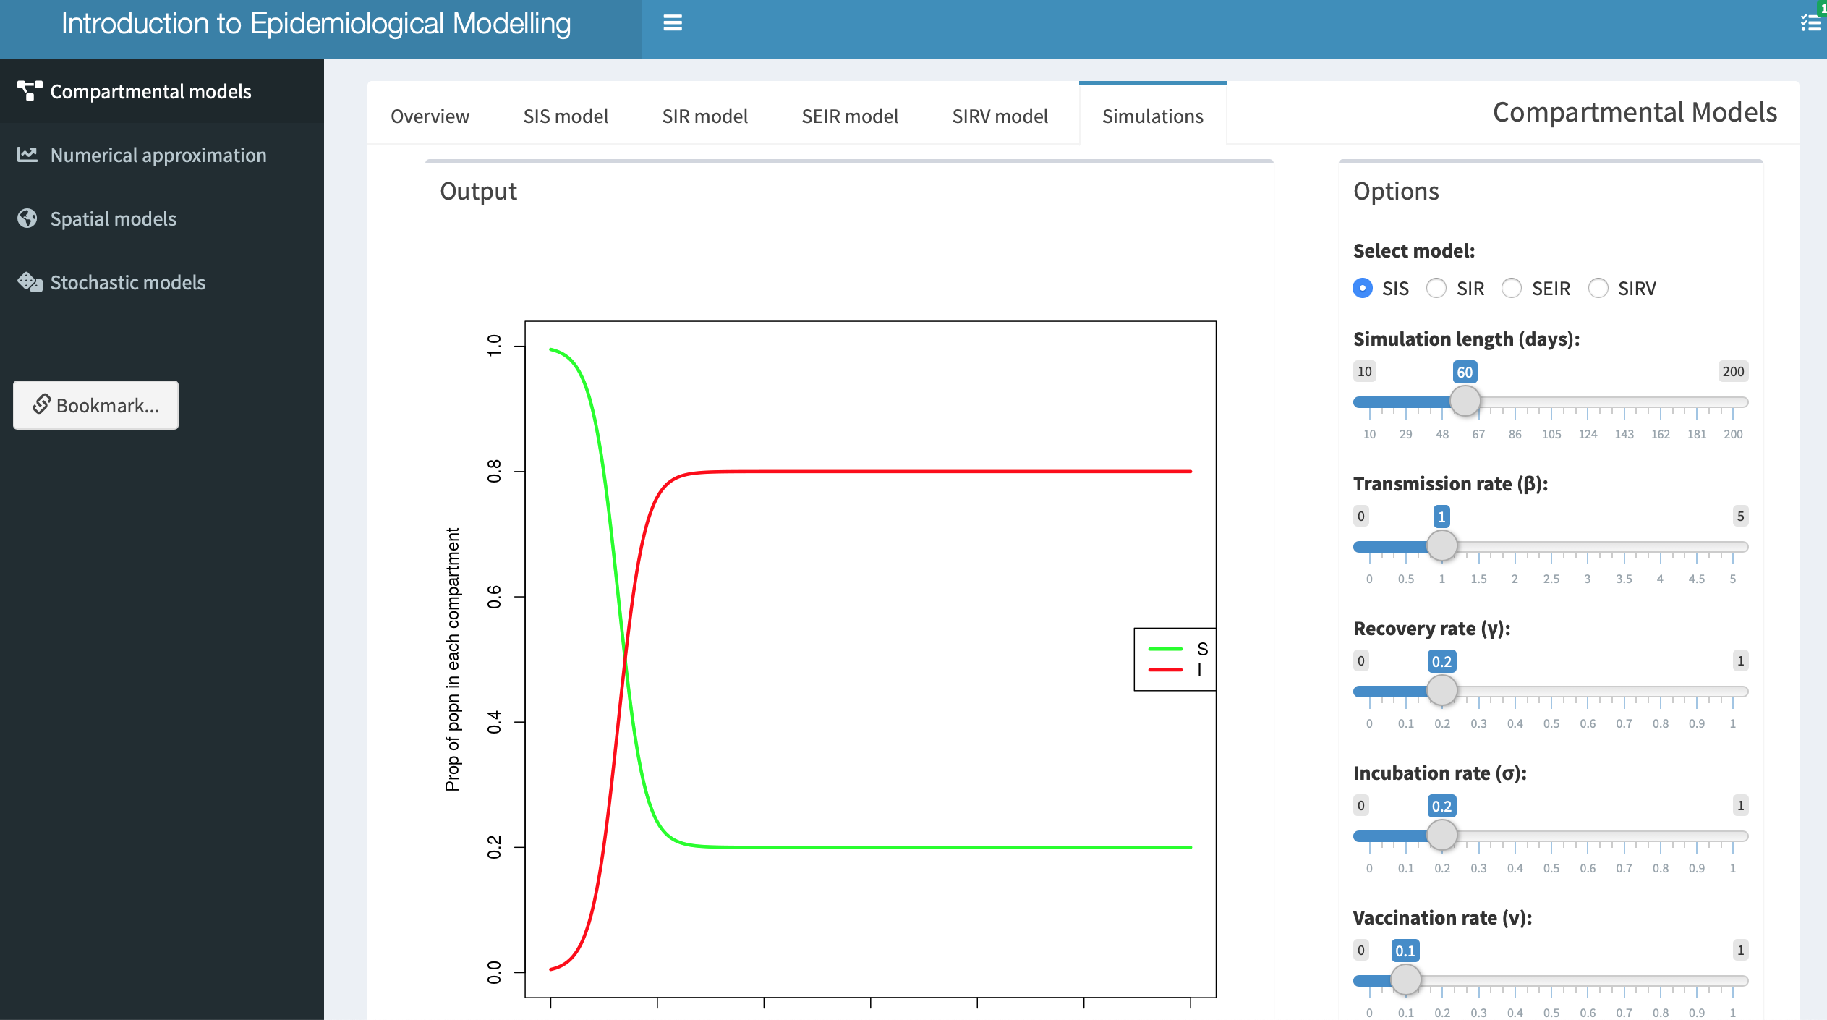
https://atkinsbd.shinyapps.io/mibtpapp/

Slide 19
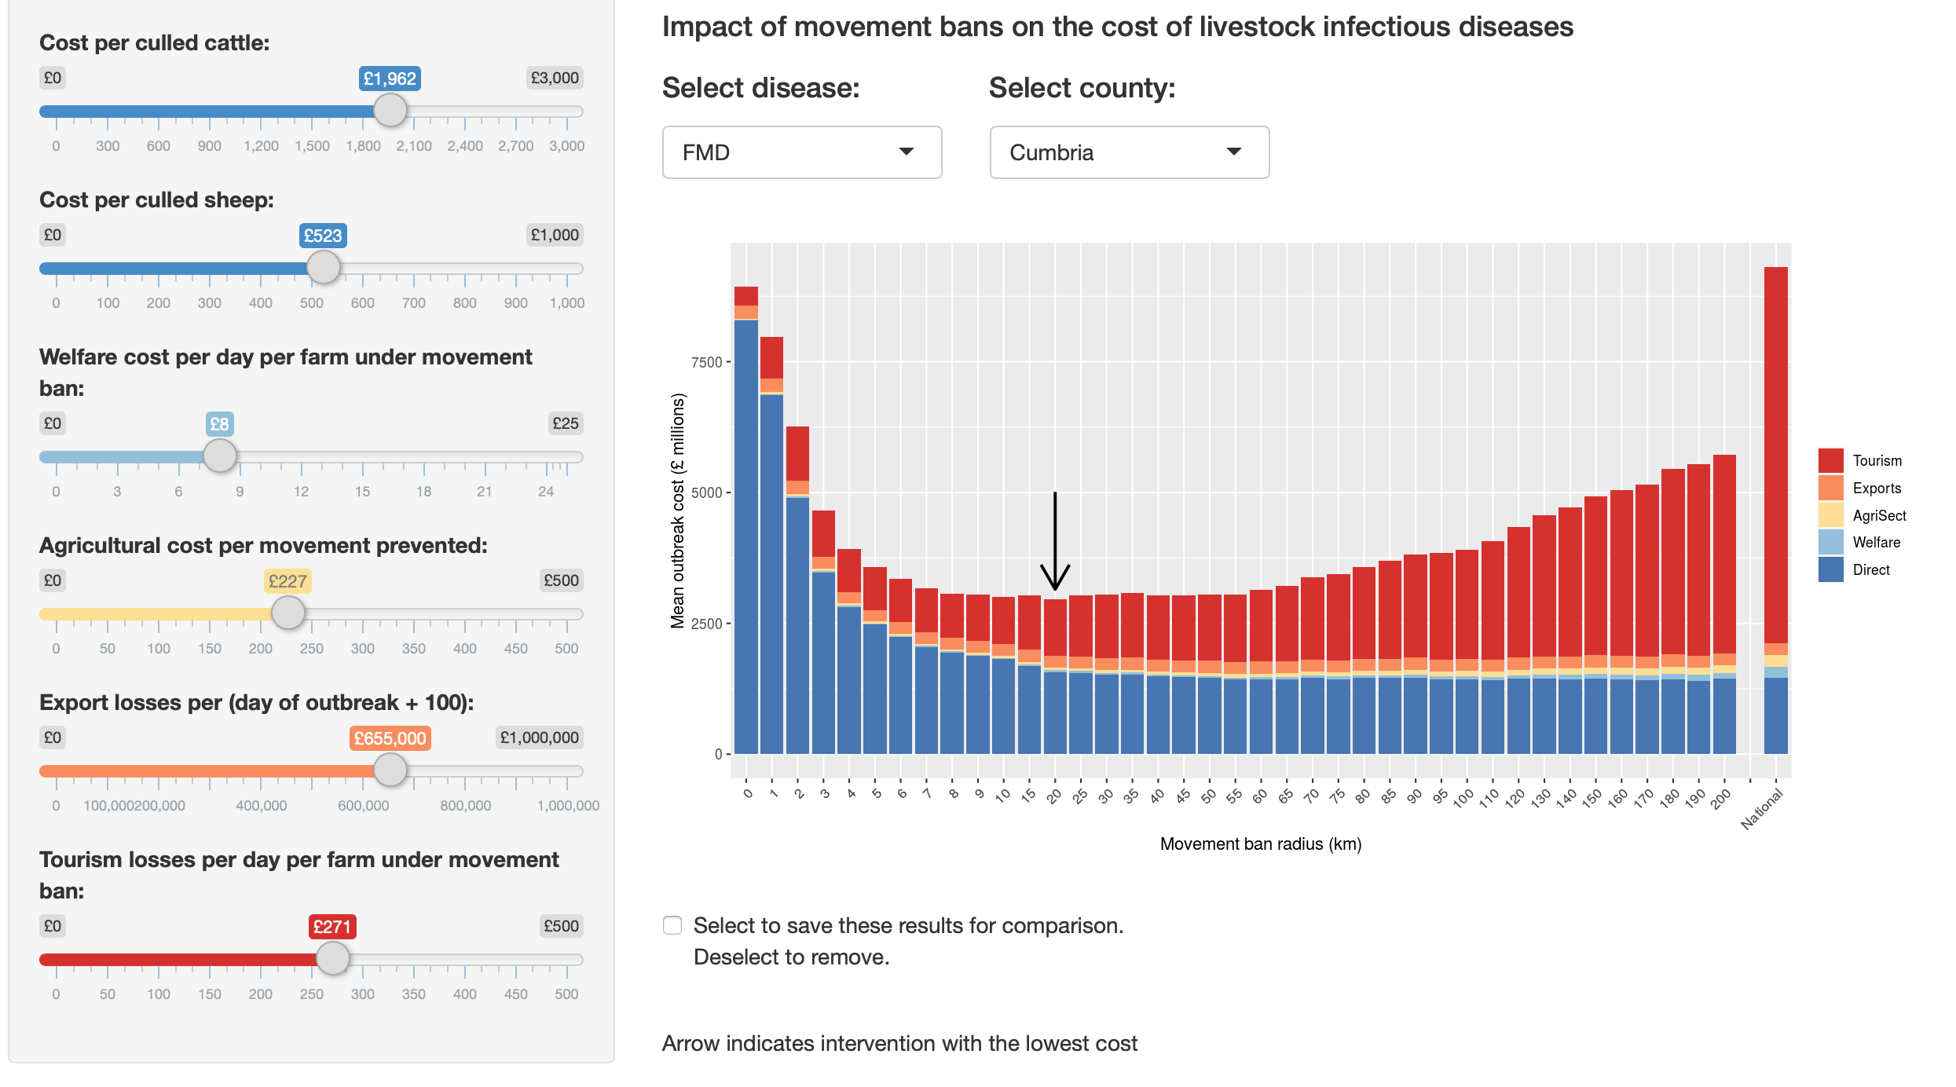
https://livestockmovements.shinyapps.io/movement_control/
Notes:
Too many visualisations to share in a static document/publication

Slide 20
What are Shiny apps?
Shiny app case studies
Introduction to Shiny

Slide 21
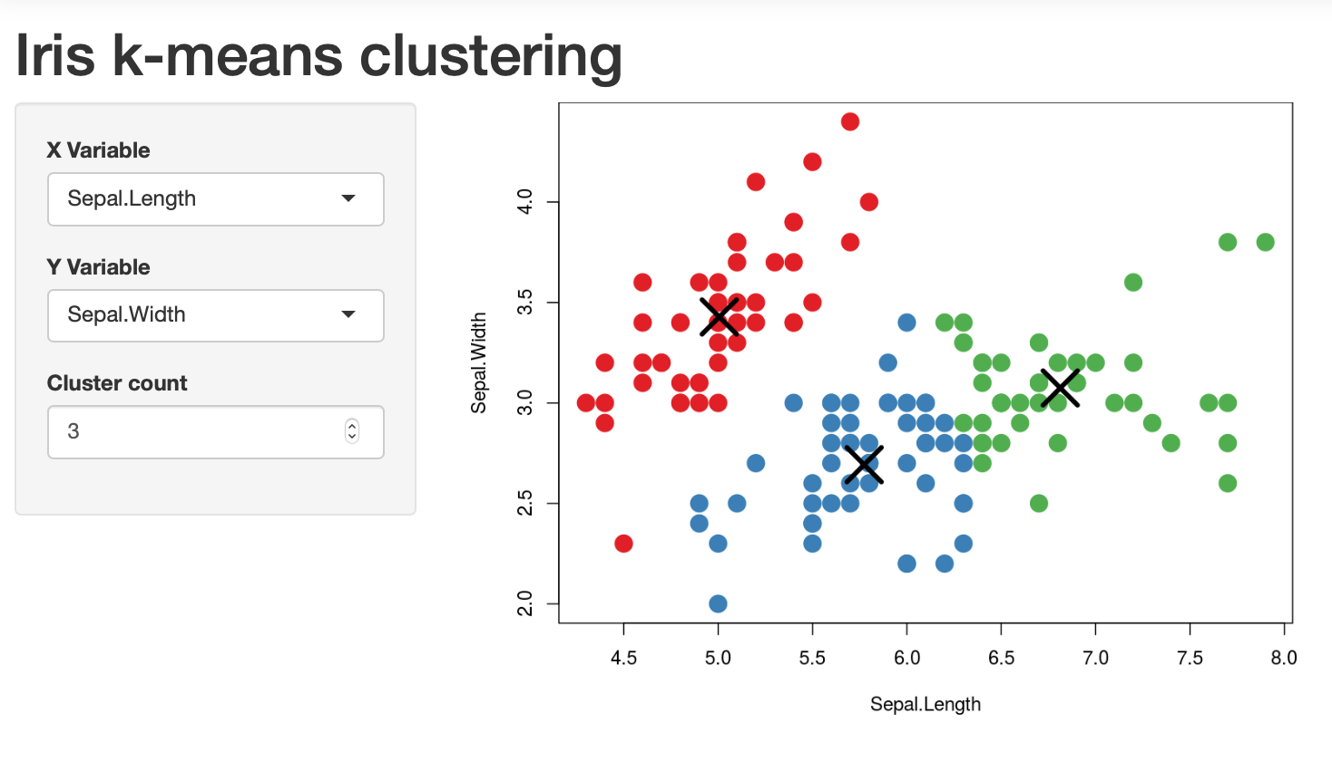
https://shiny.posit.co/r/gallery/start-simple/kmeans-example/
Notes:
Iris dataset

Slide 22
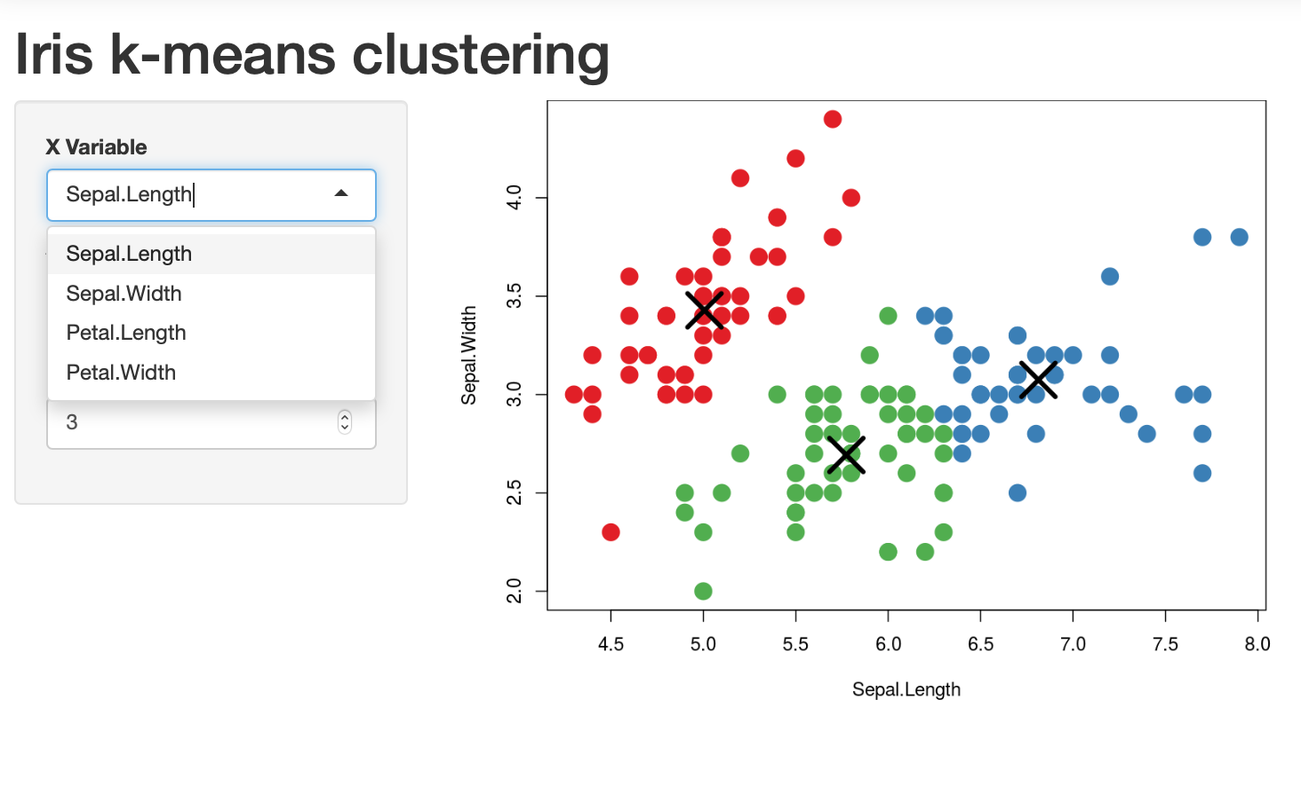

Slide 23
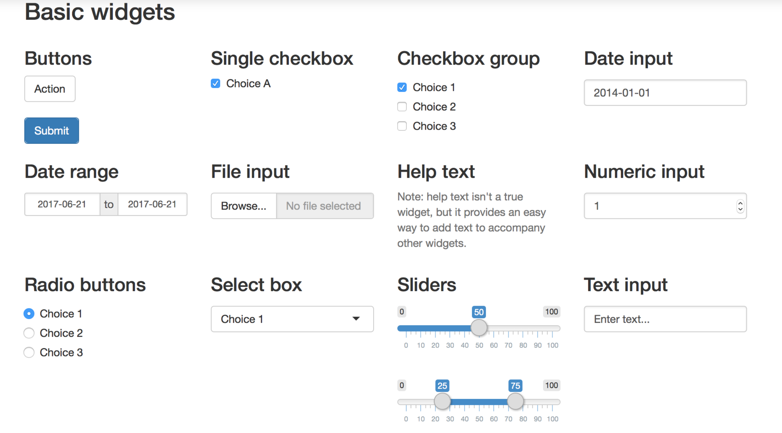
https://shiny.posit.co/r/getstarted/shiny-basics/lesson3/

Slide 24
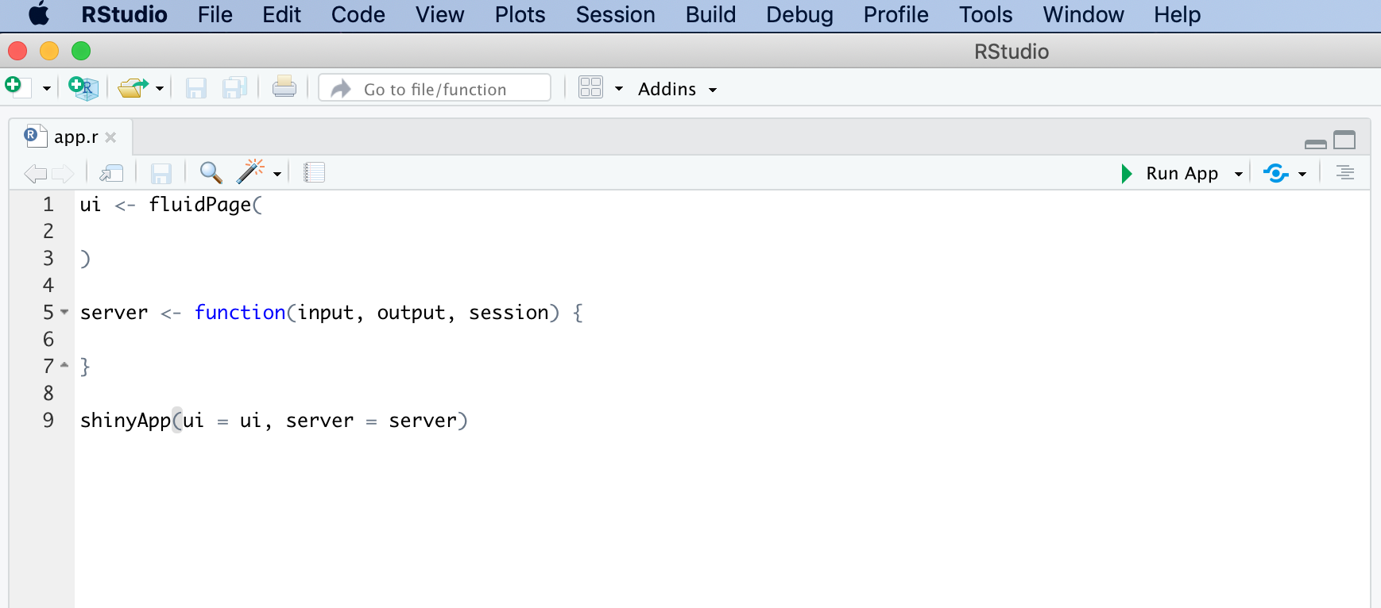
Design

Slide 26
Design
Reactivity

Slide 27
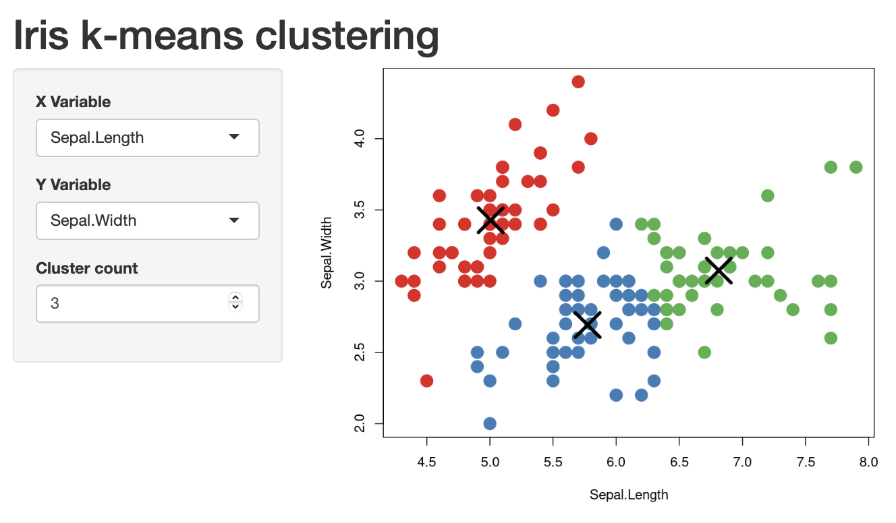

Slide 28
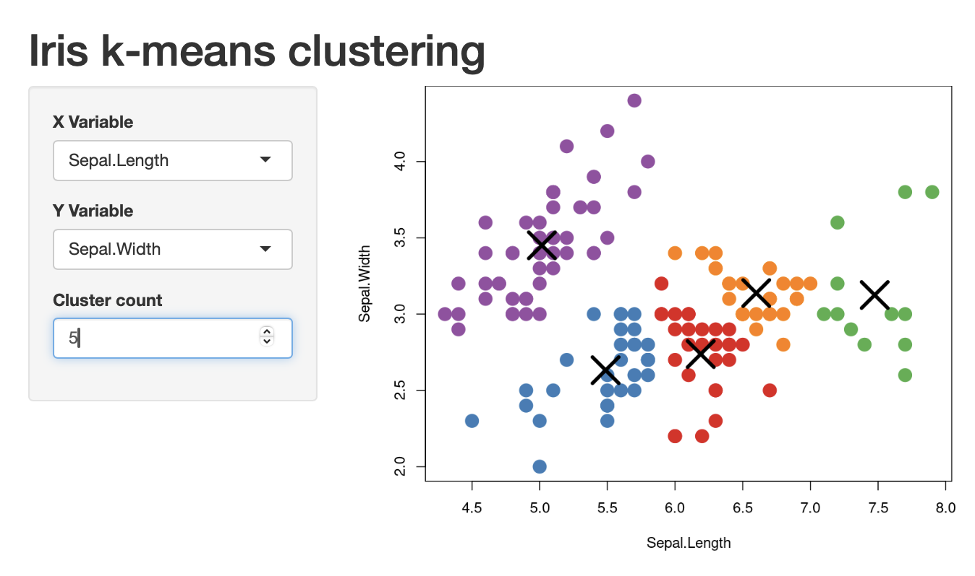

Slide 29
Design
Reactivity

Slide 30
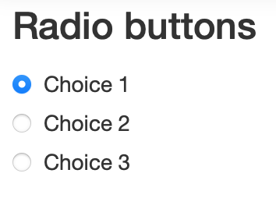
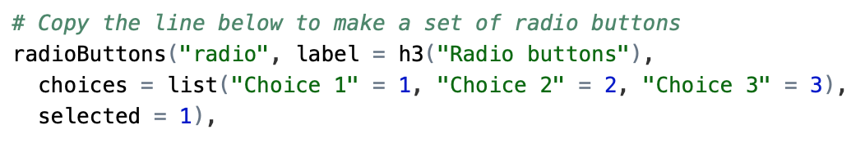
The Shiny widget gallery displays the Shiny widgets, their code and demonstrates how the output changes when you interact with them.
Alongside the code, there is also an explanation of the function arguments.
https://shiny.posit.co/r/gallery/widgets/widget-gallery/
InputId

Slide 31
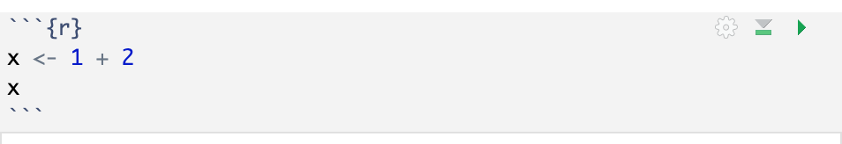
R Markdown chunks of code begin and end with ```
Click here to run the code within this chunk

Slide 32
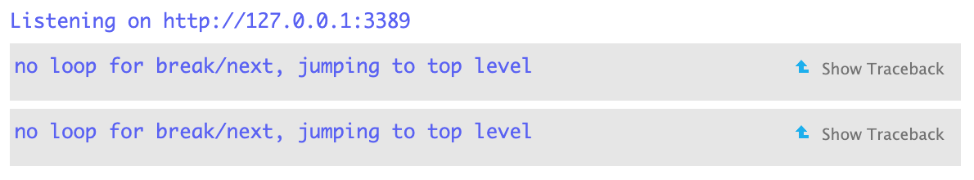

Slide 33
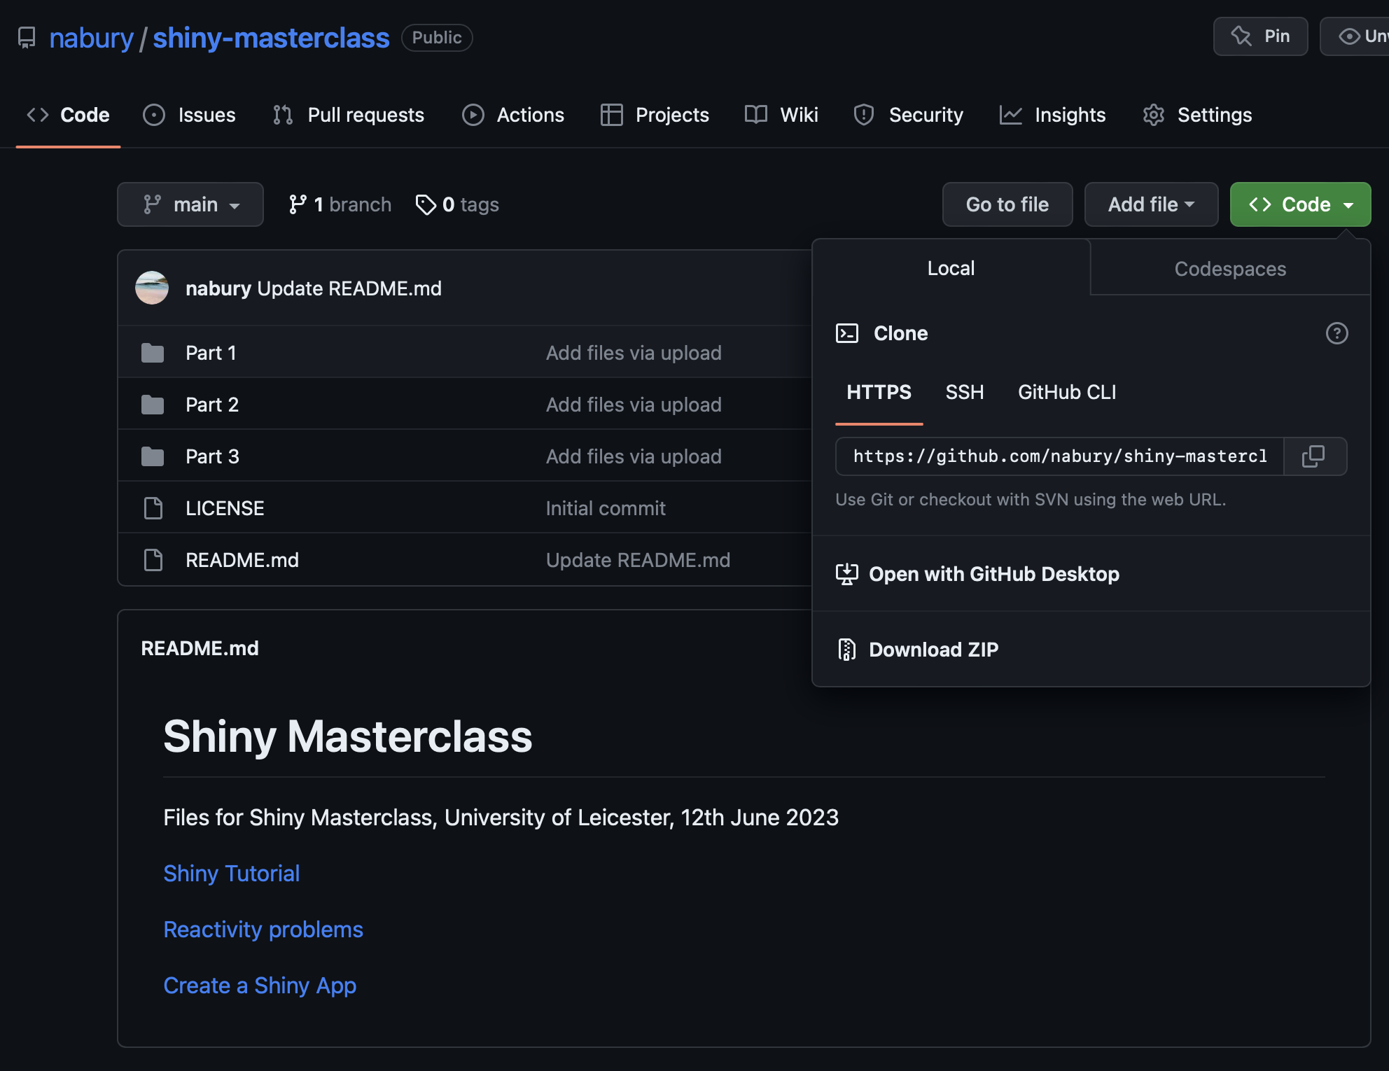

Slide 34
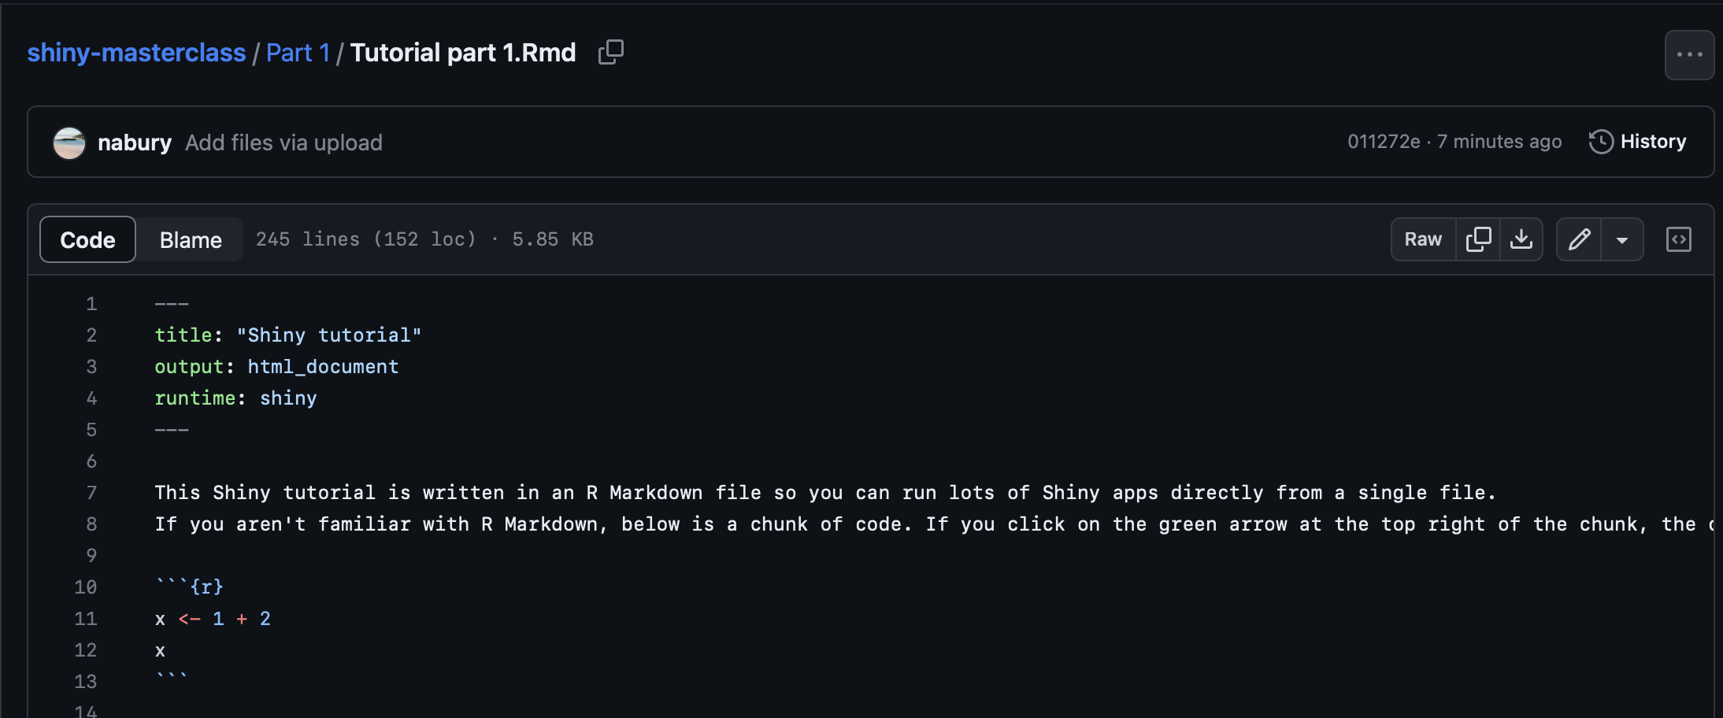

Slide 35
Now try Section A of the Shiny tutorial
Tutorial file: tutorial.Rmd
You may need to install rmarkdown if you haven’t used it before:
install.packages(“rmarkdown”)
Let me know when you get to the end of Section A
All files for today are available at: https://github.com/nabury/shiny-masterclass

Slide 36
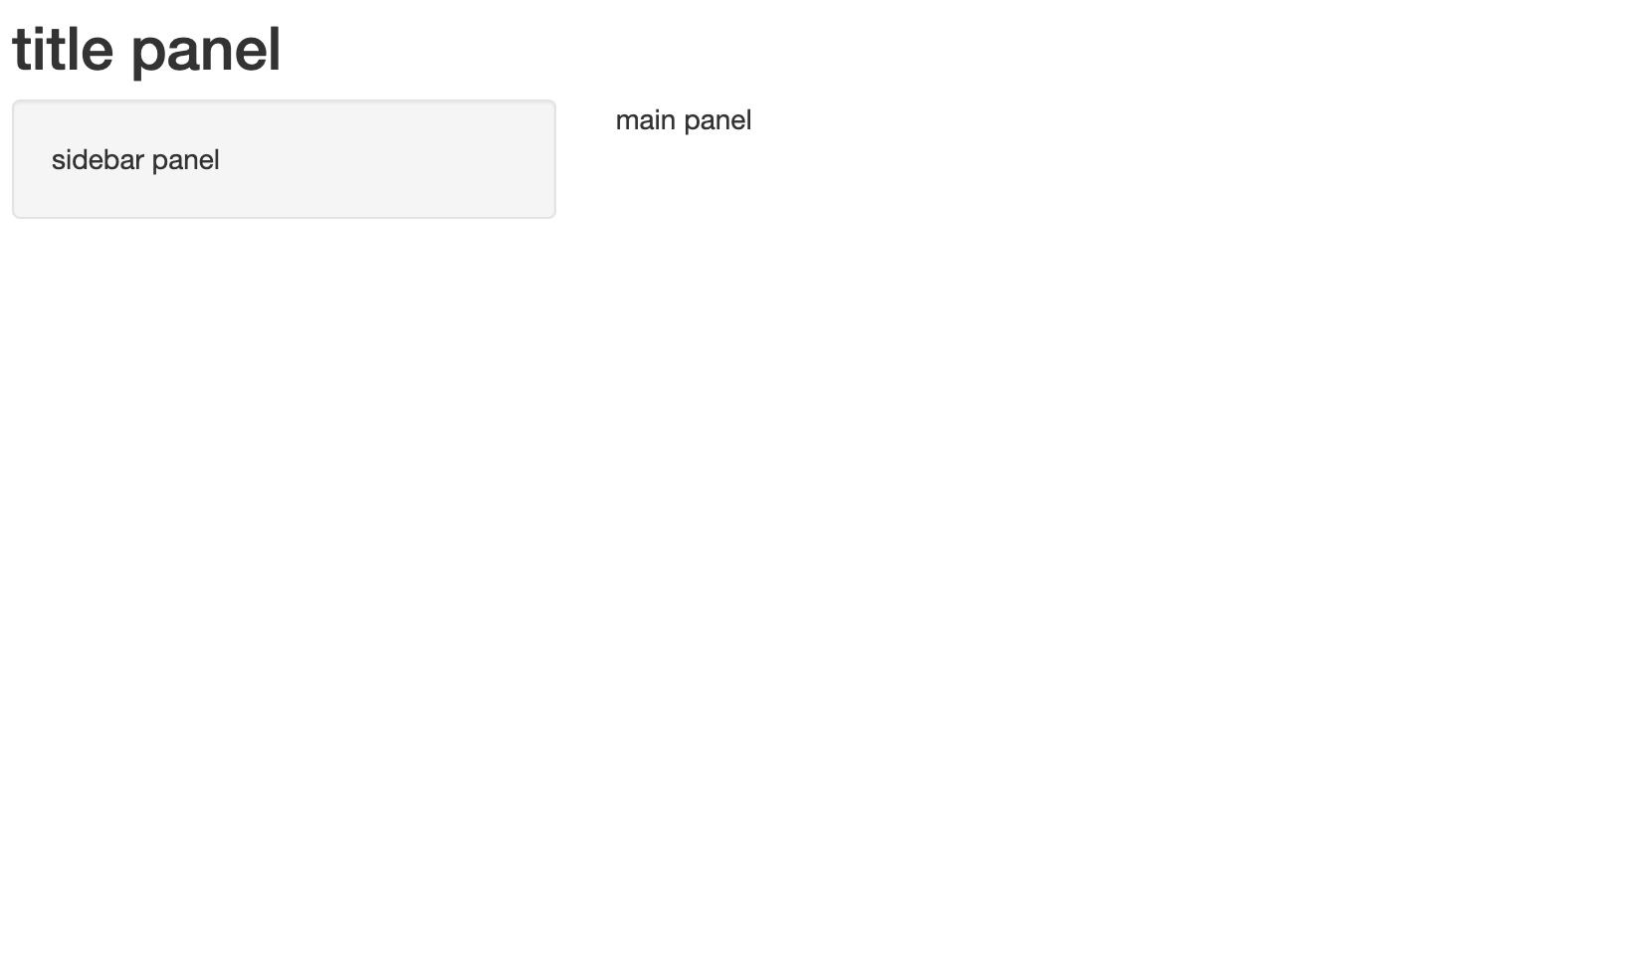

Slide 37
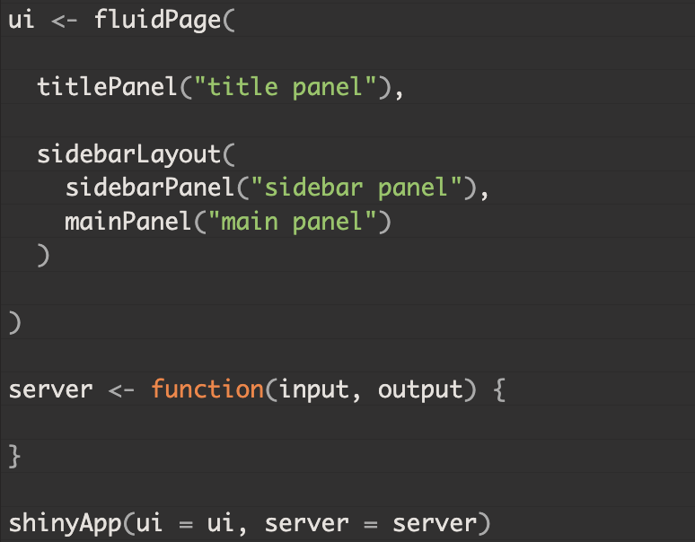

Slide 38
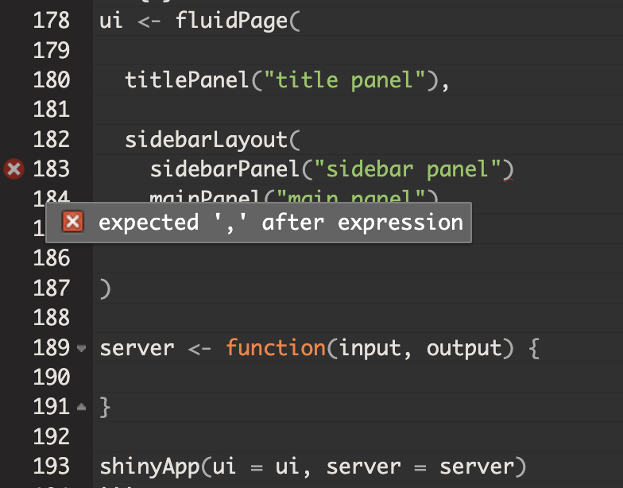

Slide 39
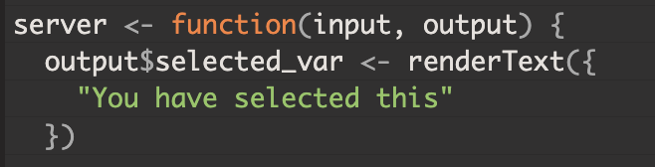
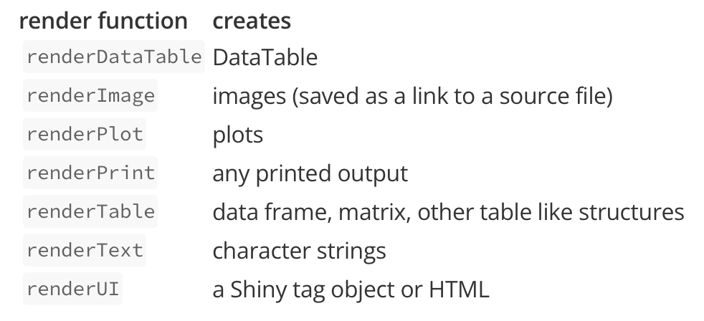
Notes:
Now we want to make reactive (not static) outputs

Slide 40
Each render* function takes a single argument: an R expression surrounded by braces, {}.
The expression can be one simple line of text, or it can involve many lines of code.
Shiny will run this code when you first launch your app, and then Shiny automatically re-run the instructions every time it needs to update your object.
For this to work, your expression should return the object you have in mind (a piece of text, a plot, a data frame, etc.).
You will get an error if the expression does not return an object, or if it returns the wrong type of object.

Slide 41
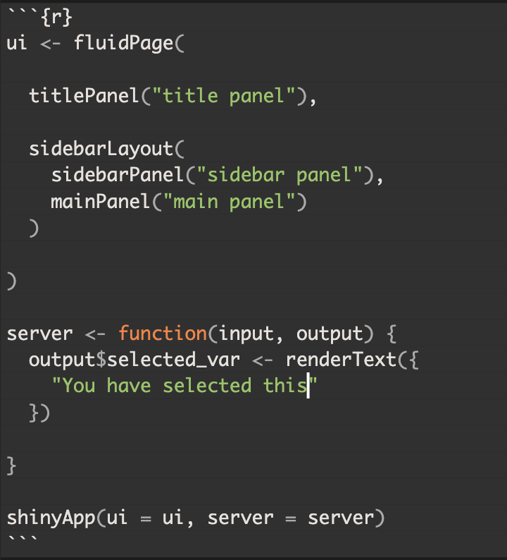
Notes:
If you run the previous app only an empty page will be displayed.

Slide 42
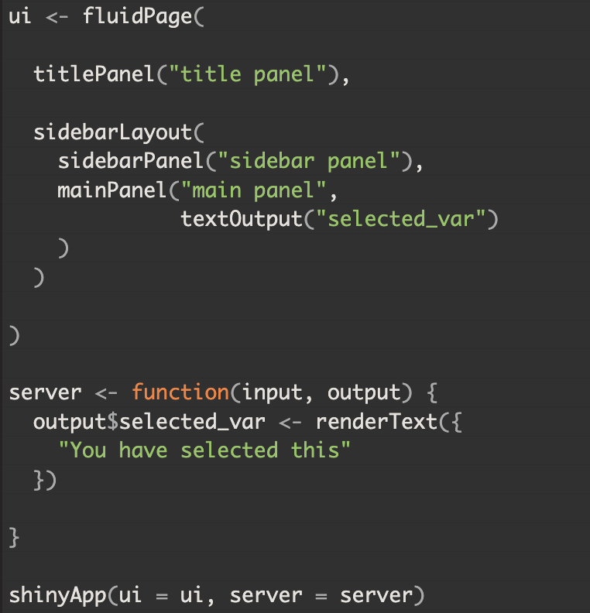
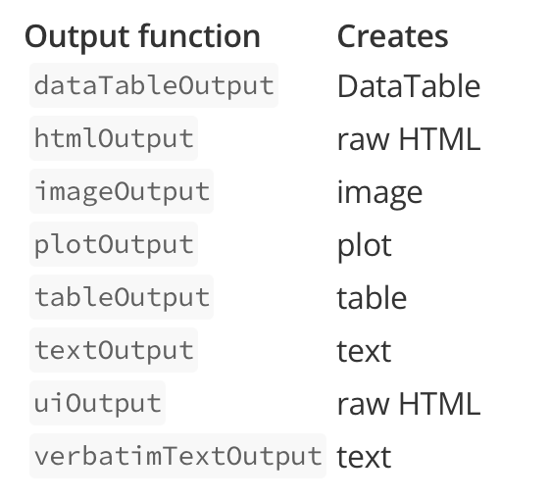

Slide 43
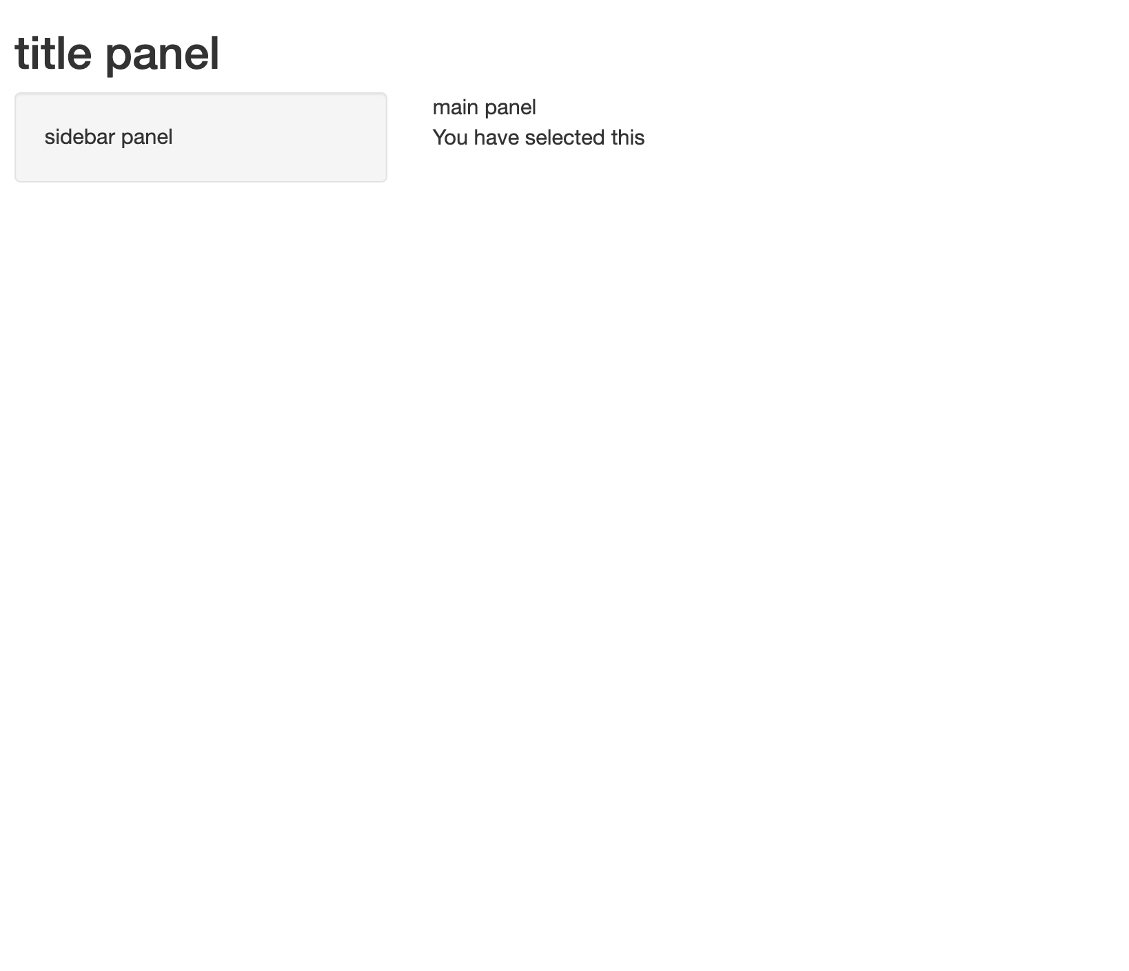

Slide 44
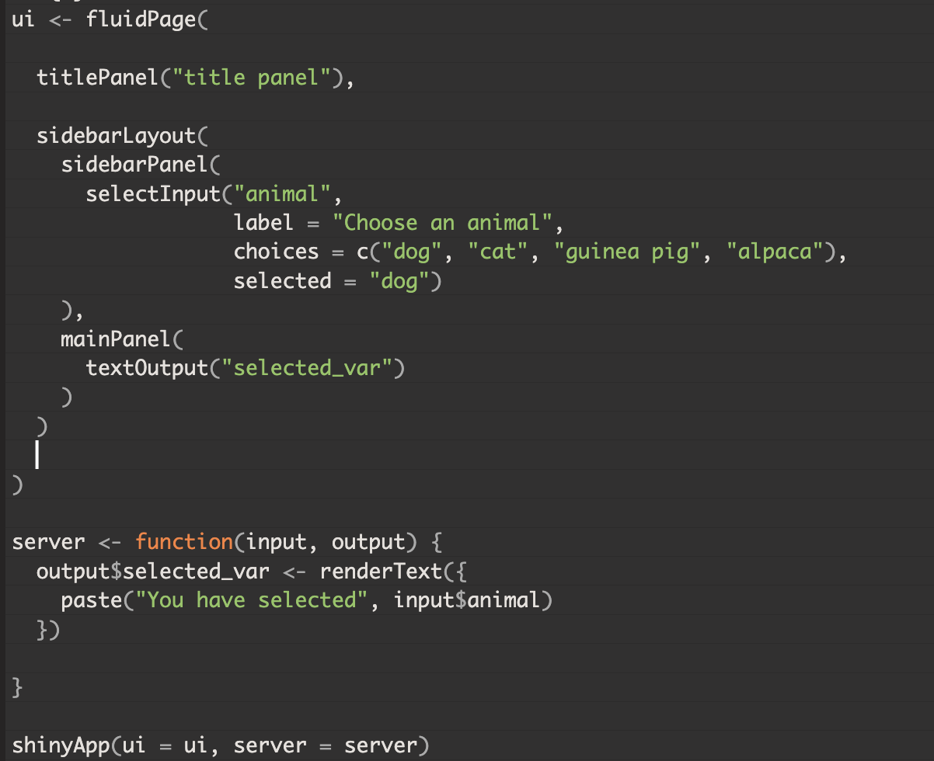

Slide 45
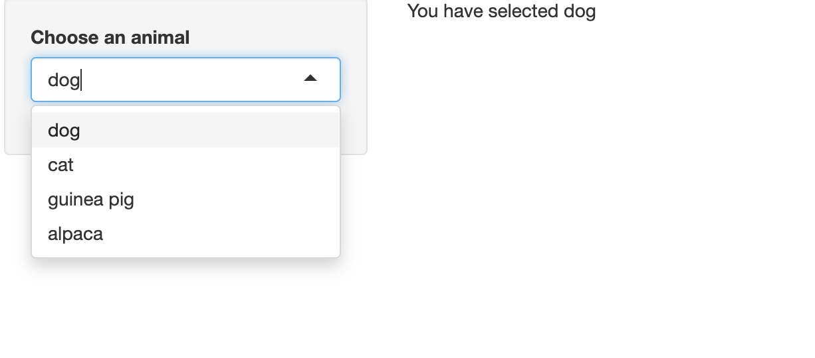

Slide 46
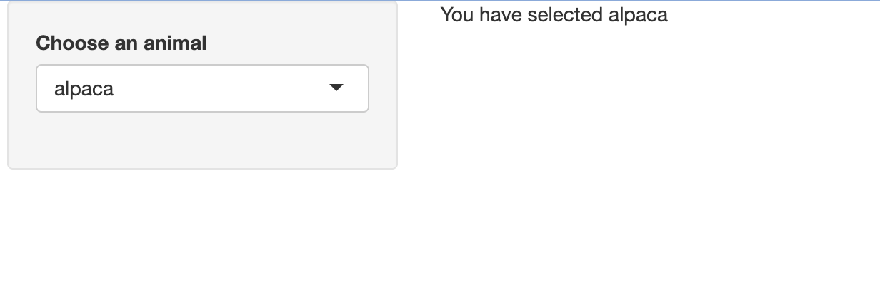

Slide 47
Now try section B of the Shiny tutorial

Slide 48
Creating your own shiny app
Notes:
Not using rmd any more

Slide 49
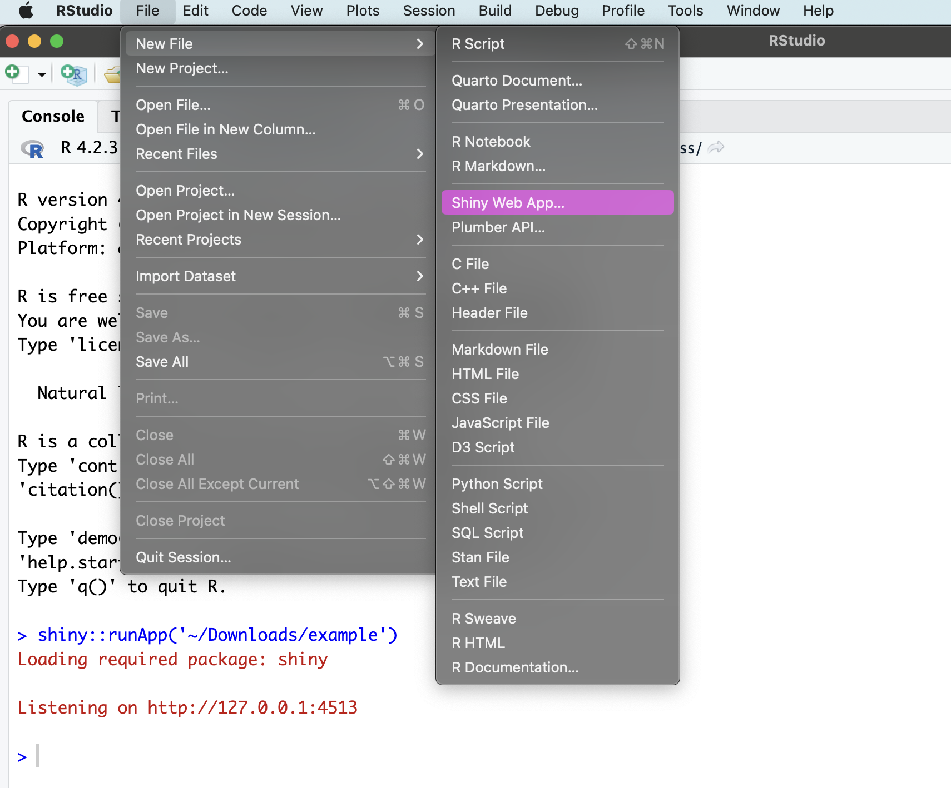

Slide 50
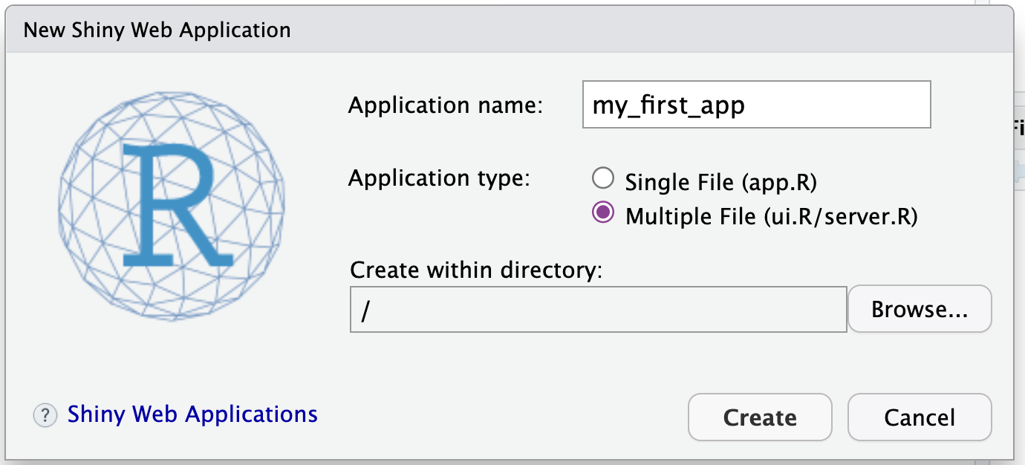

Slide 51
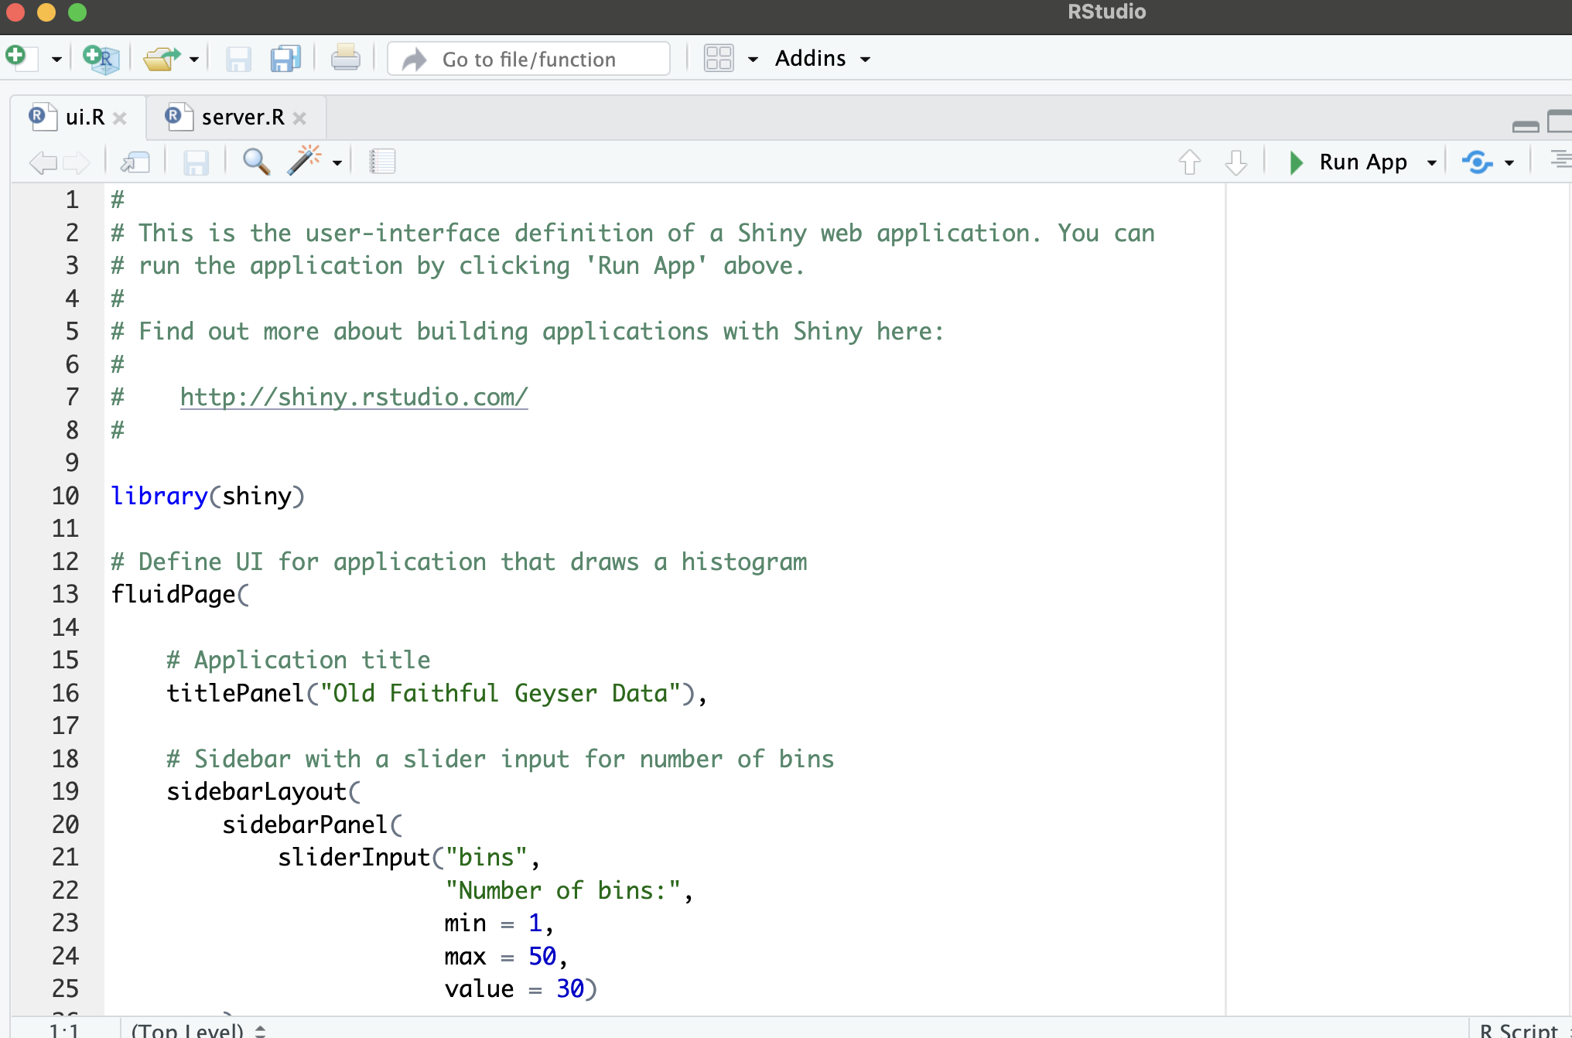

Slide 52
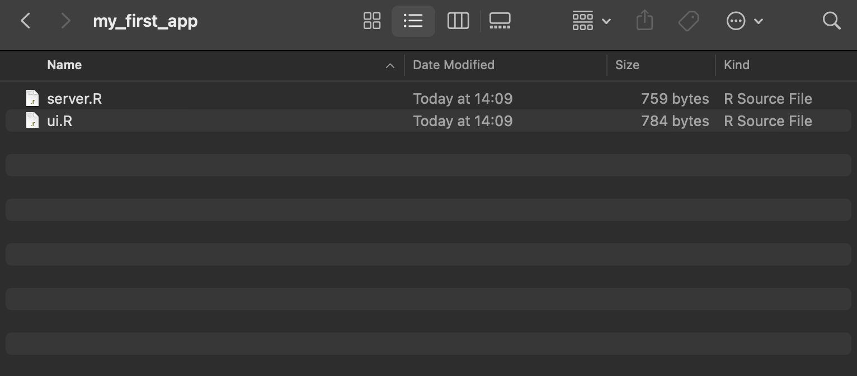
You can store other files in this directory such as the data imported into the app or helper functions that you may not want in your main code
See this section of the Shiny tutorial for more detail:
https://shiny.posit.co/r/getstarted/shiny-basics/lesson5/

Slide 53
R Studio automatically recognises Shiny apps

Slide 54
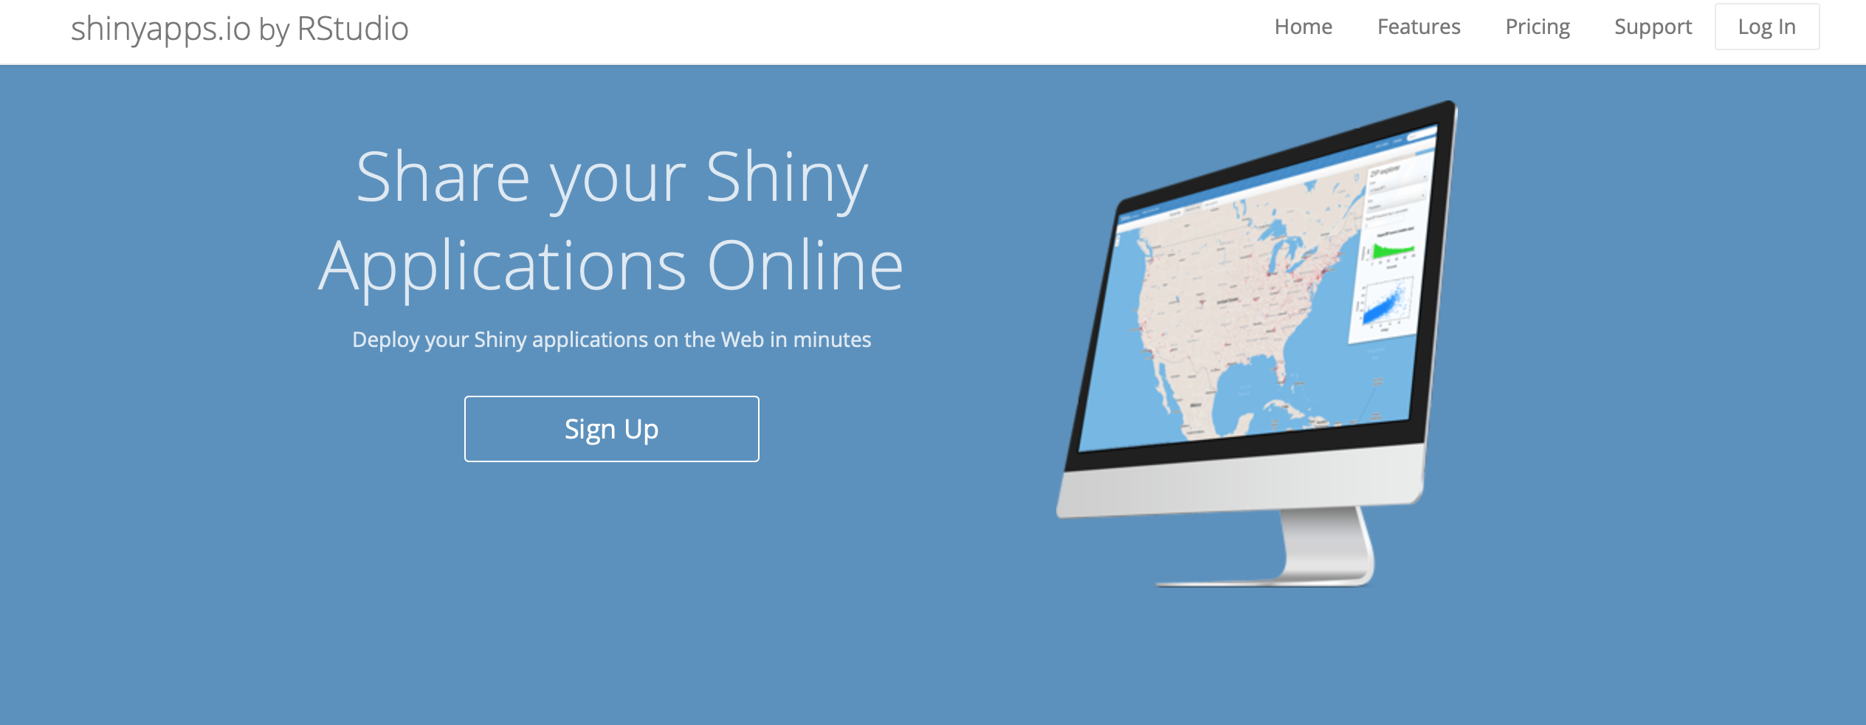
There are several ways to share Shiny apps
The easiest of these is by using the site https://www.shinyapps.io
A free account account with shinyapps.io allows you to publish up to 5 apps online at a time
You can then share your app with anyone

Slide 55
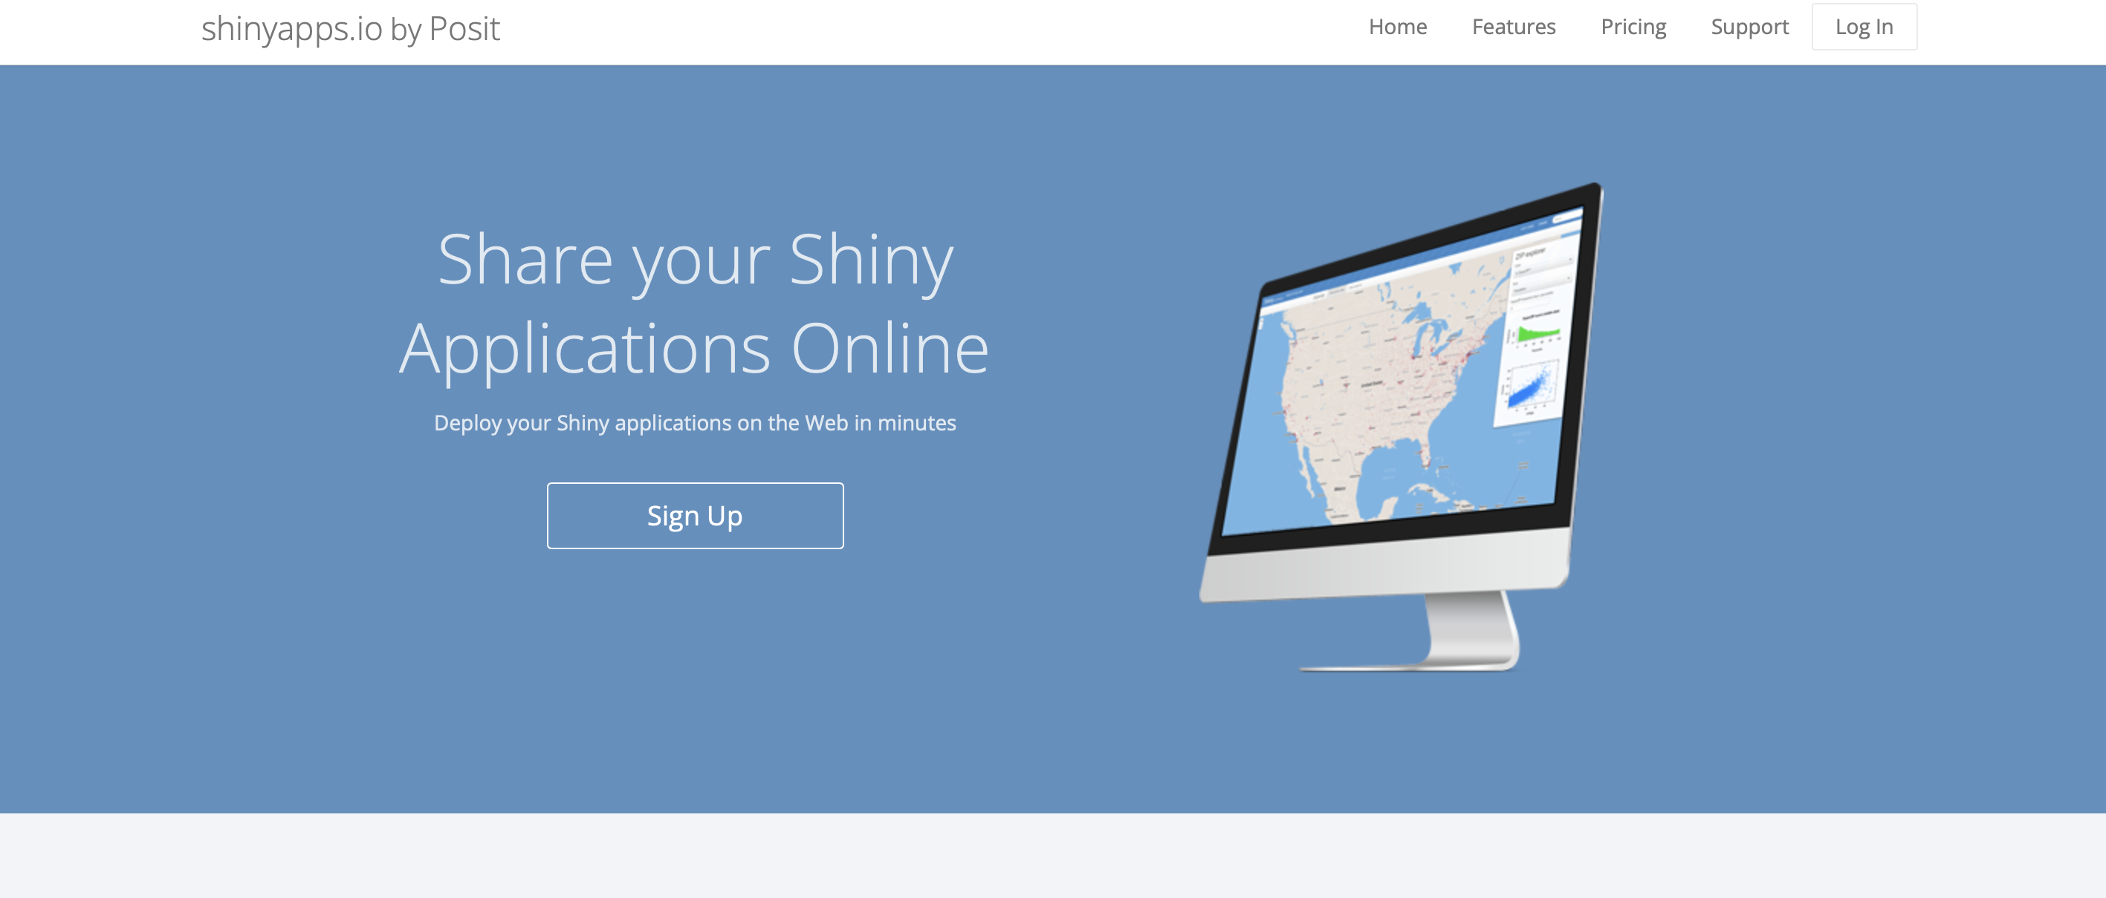

Slide 56
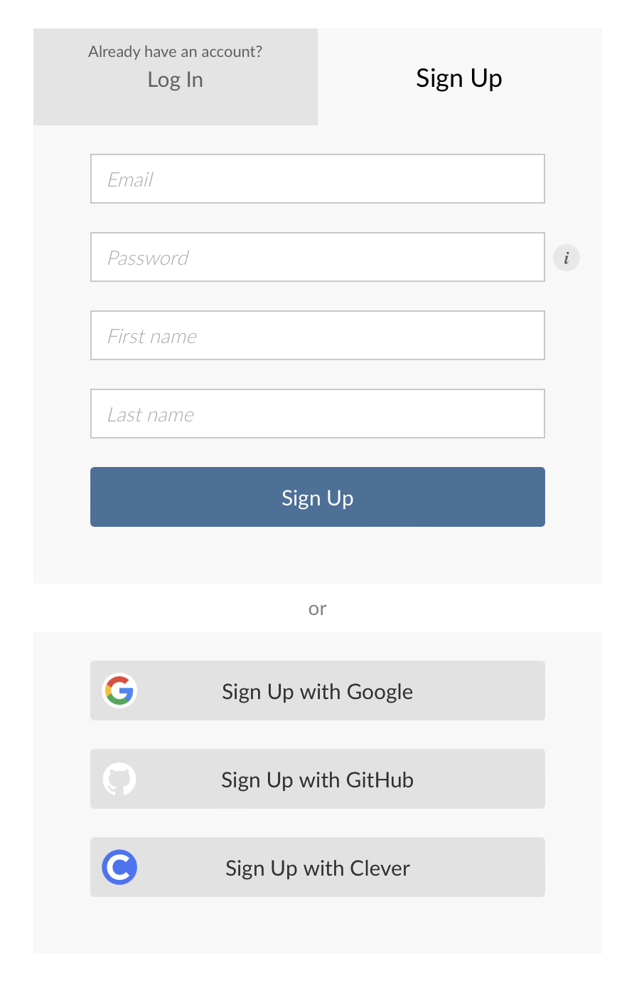

Slide 57
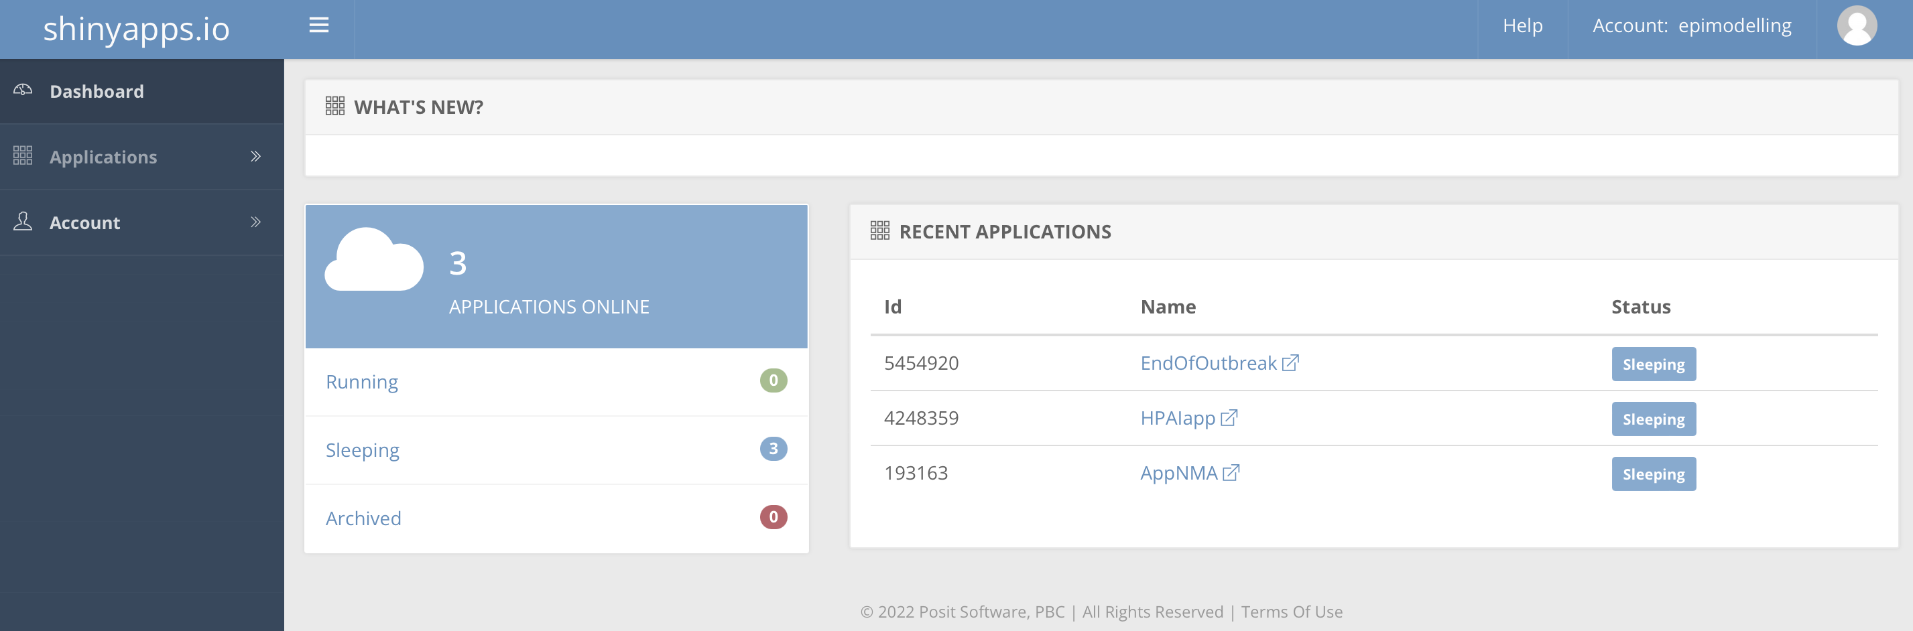

Slide 58
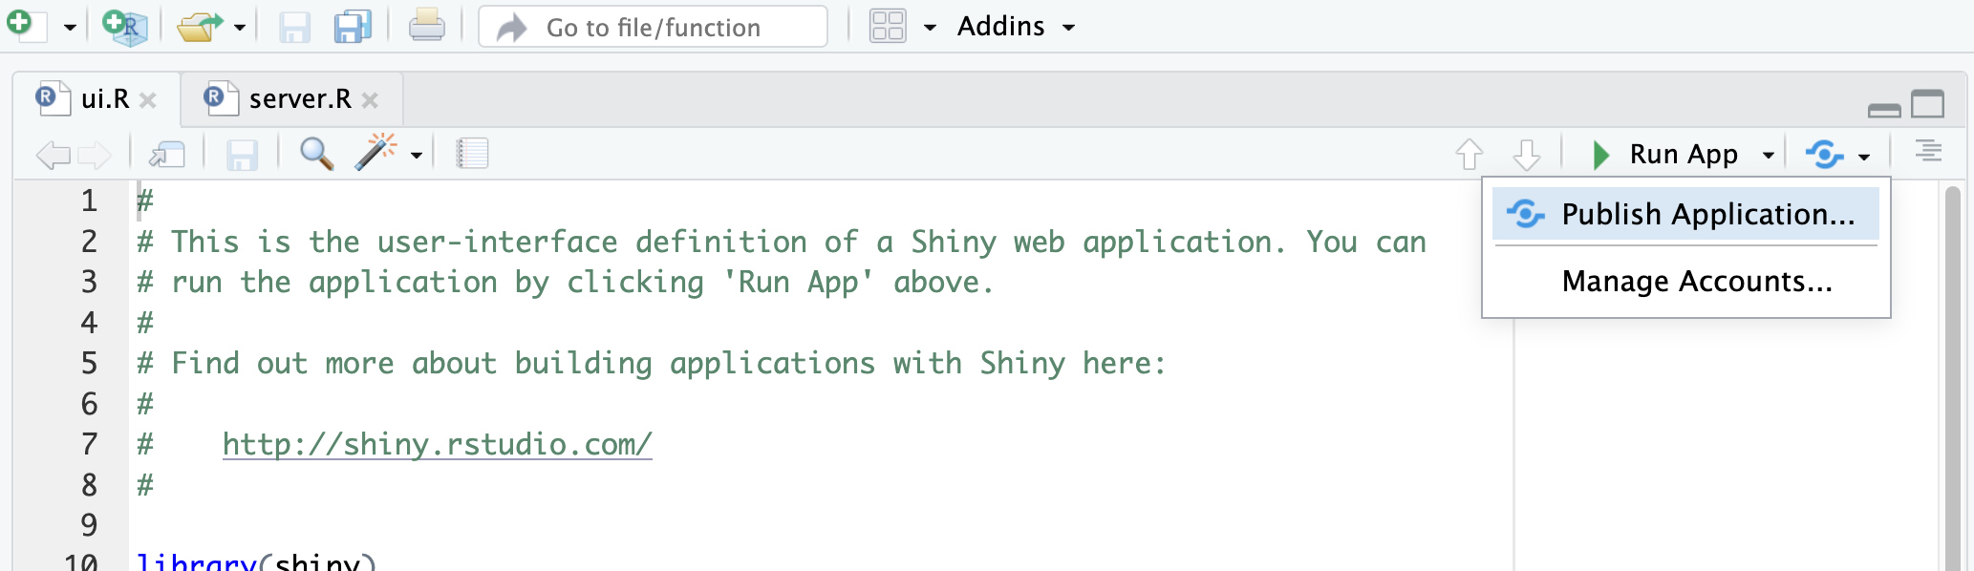

Slide 59
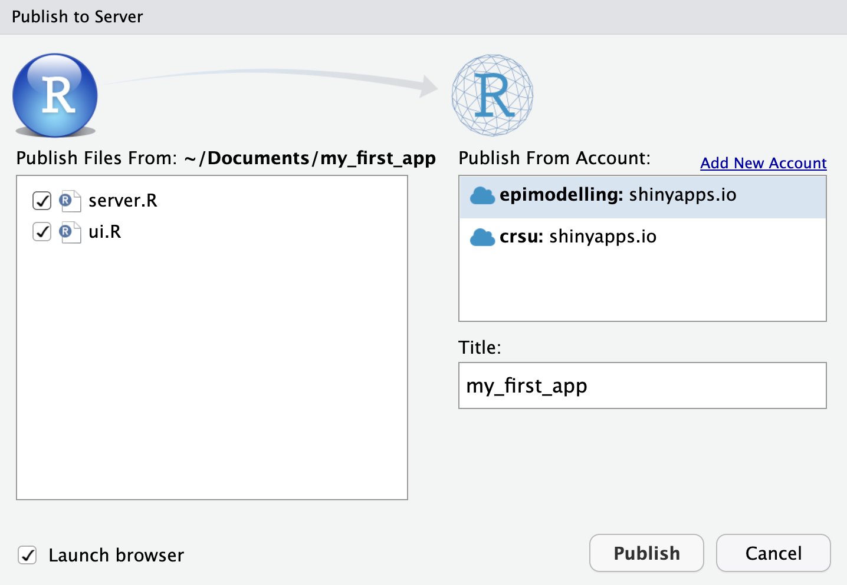
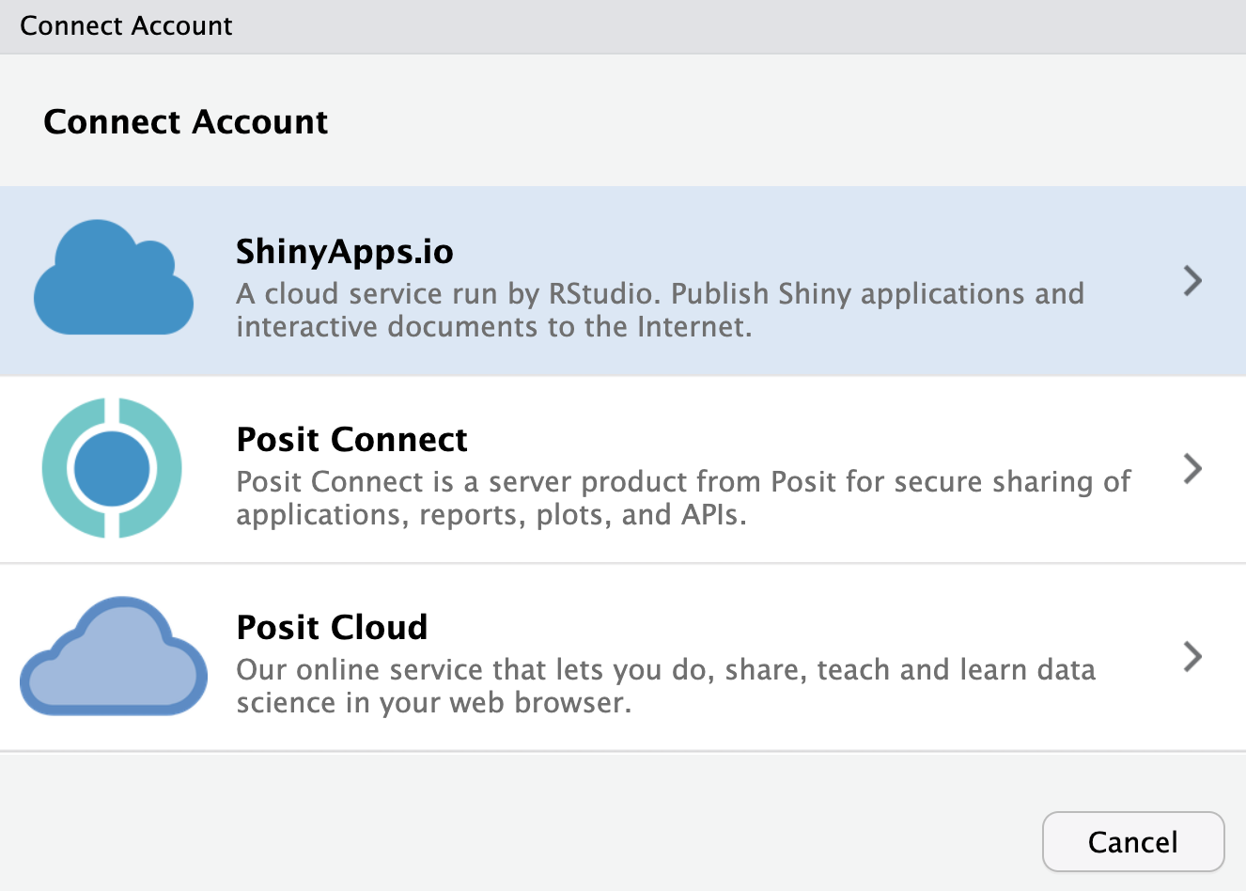

Slide 60
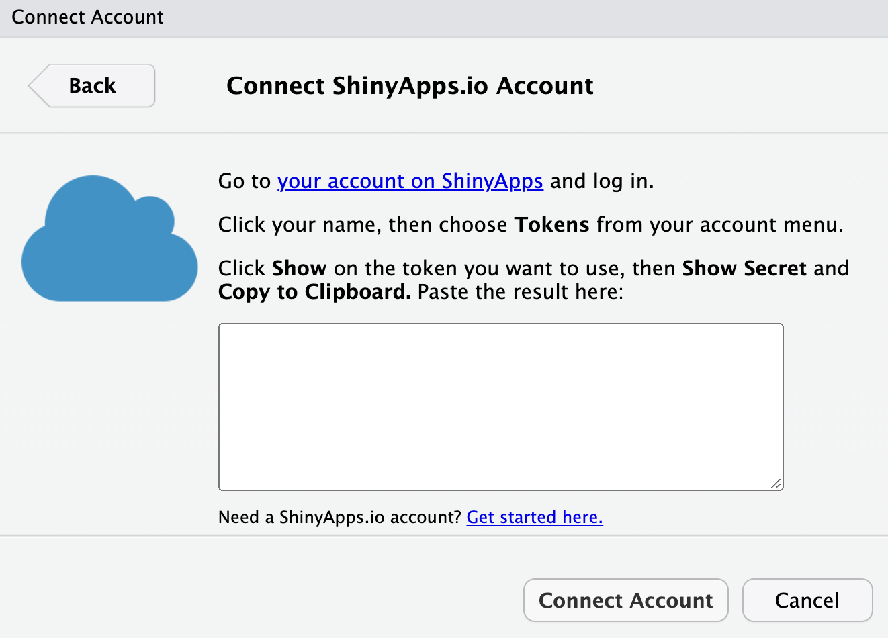

Slide 61
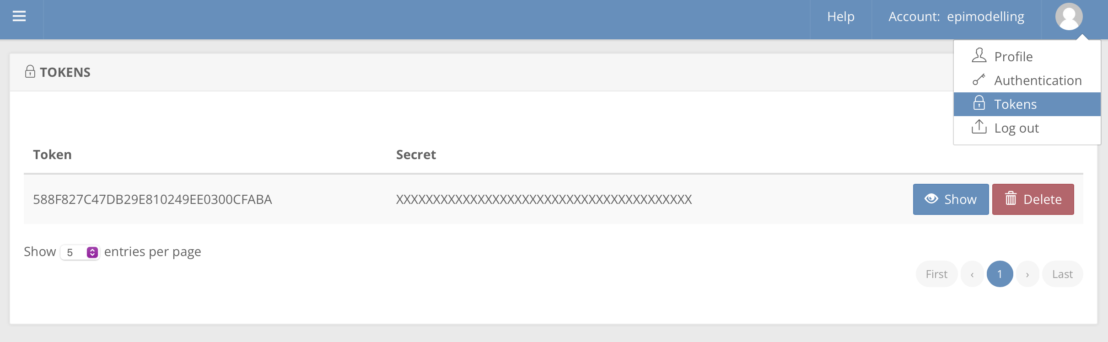

Slide 62
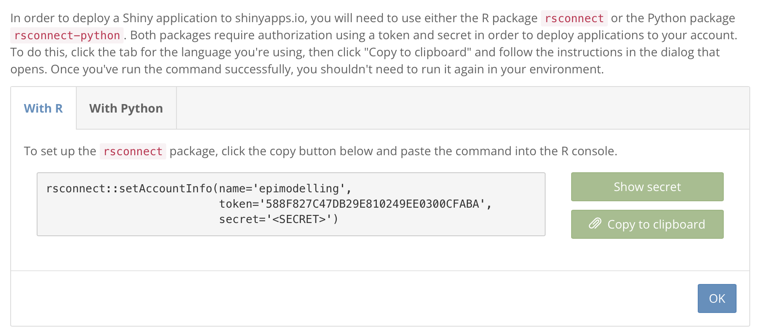

Slide 64
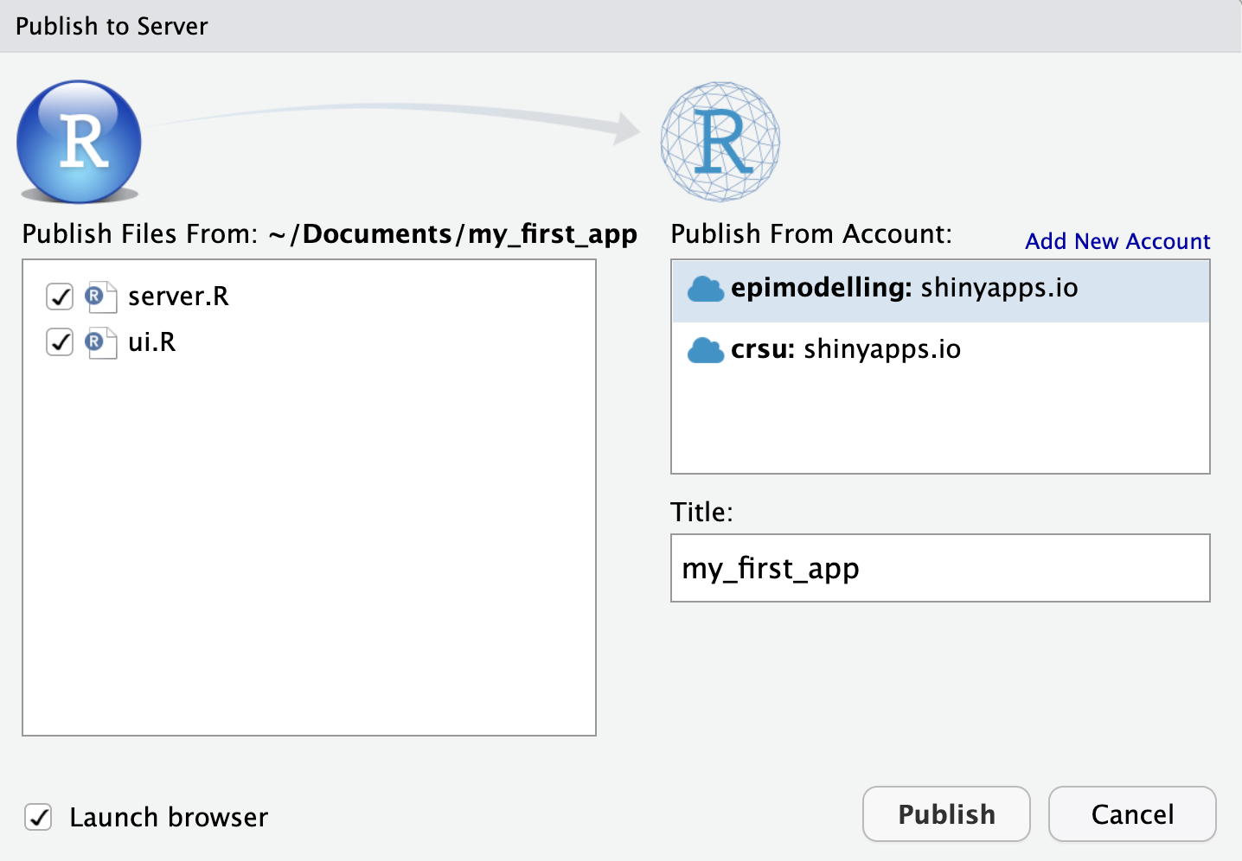

Slide 65
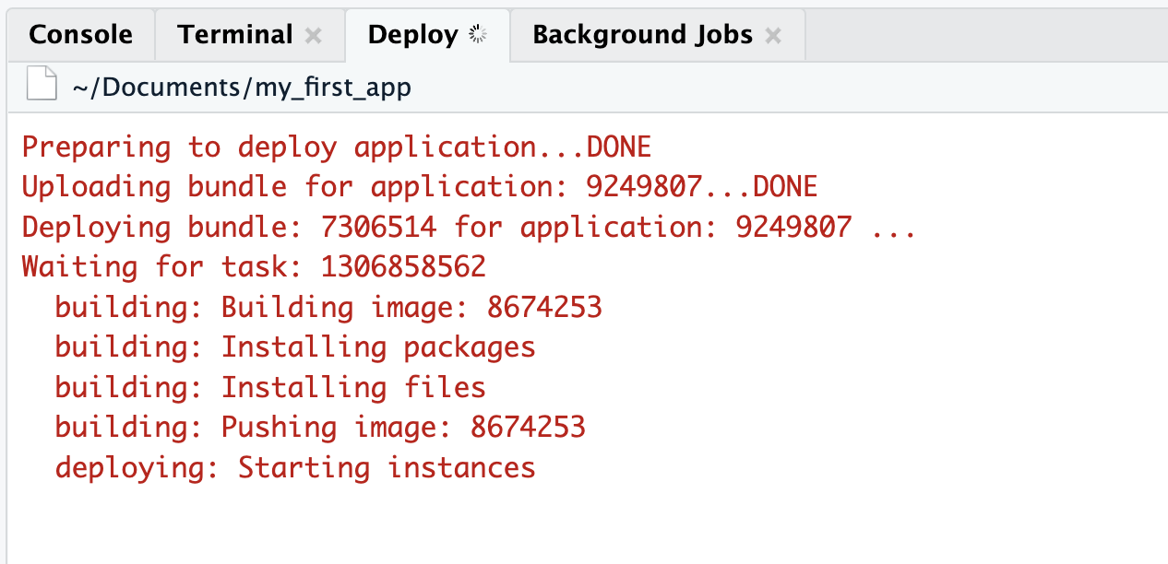

Slide 66
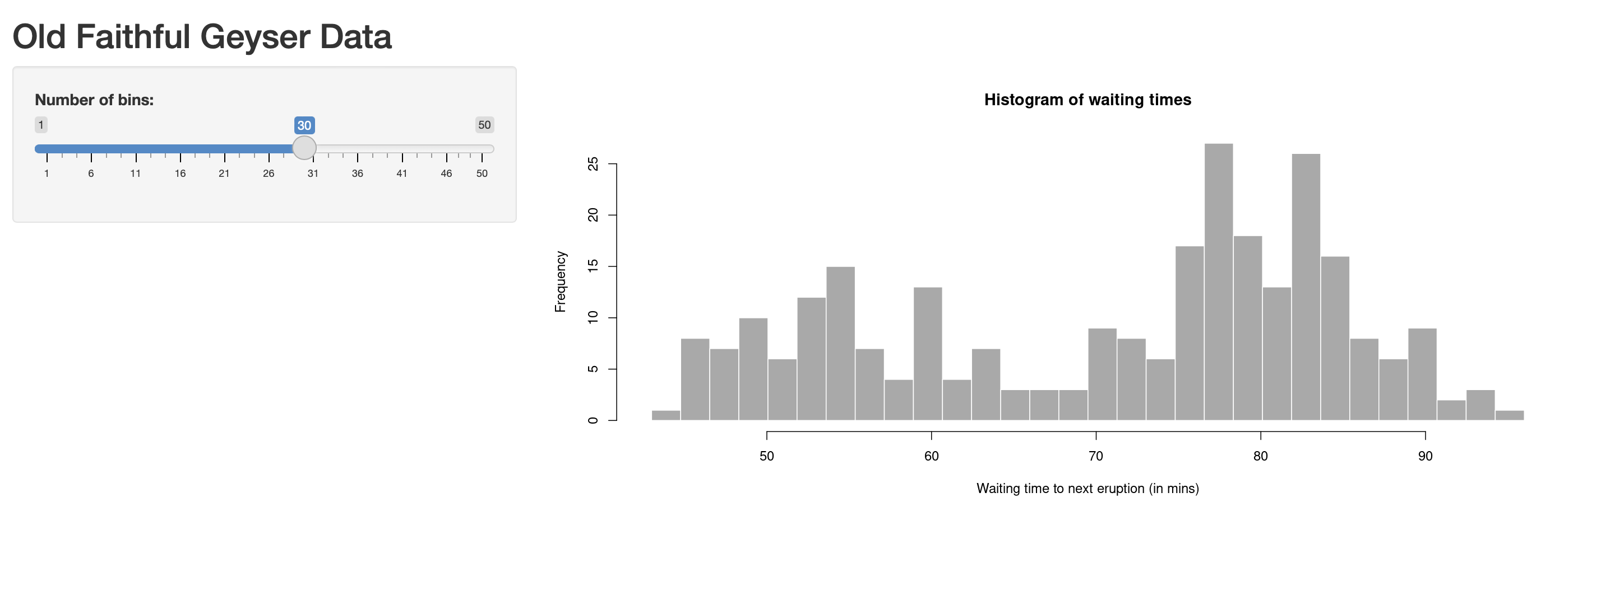
Your app will be at hosted at this location: https://youraccountname.shinyapps.io/my_first_app/

Slide 67
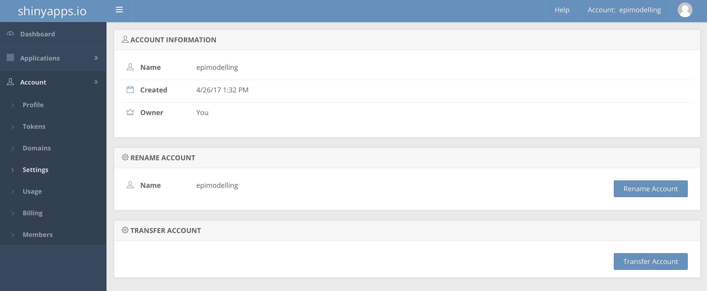

Slide 68
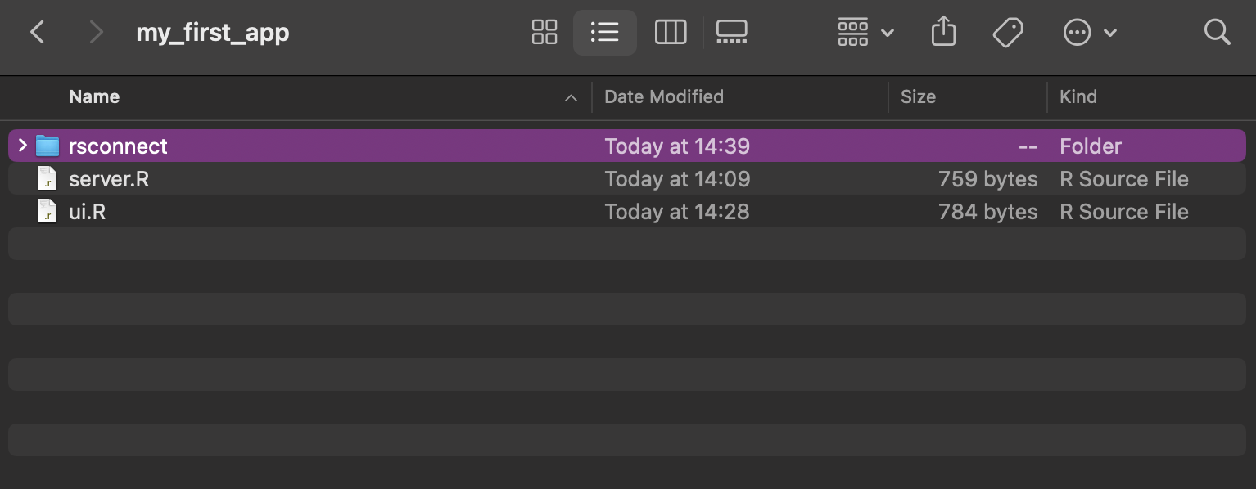

Slide 69


Slide 70
Your Turn
Take the code you wrote in the tutorial and use it to create your own standalone Shiny app in R Studio (remember to remove any rmarkdown)
Create an account on shinyapps.io and link it to R Studio
Upload your first app to shinyapps.io

